Slide 1
KFTHC Volunteer Orientation
Thank you for your interest in becoming a volunteer at KFTHC! Volunteers make the services we offer possible and we value your interest in helping us make KFTHC a safe, fulfilling and fun place for people with disabilities to exceed their own expectations!
To view this slide show, please go to the menu bar and click on “Slide Show”, then click ‘From Beginning”.
Click to advance to the next slide.
To access the audio portion, find the speaker icon and click for each slide.

Slide 2

Kentucky Foothills Therapeutic Horsemanship Center
Volunteer Orientation
Online
Click Here for Narration→

Slide 3
Greetings,
You are accessing the KFTHC online Volunteer Orientation option.
Please watch this slide show in its entirety and be prepared to answer questions about the content.
You will find these questions on the last page of this slide show. When you arrive at KFTHC for part 2 of the Orientation, “Working With KFTHC’s Horses” you may be asked by an KFTHC staff member to answer these questions. Don’t stress, we want you to succeed!
Thank you for your interest in volunteering at KFTHC. Remember, our attention to these details is important for the safety of our volunteers, our participants, our staff and our horses.
Thank you,
Cheryl Martin M.Ed., Program Director and Lead Instructor

Slide 4
Welcome to KFTHC!!
KFTHC wants your experience to be safe, rewarding, therapeutic and fun. It is essential for our participants and horses that we uphold consistency in KFTHC activities, procedures and policies. The hows and whys of the KFTHC way of doing things will be explained in this presentation and during Skills Development Opportunities Days. If you have any questions, please don’t hesitate to ask. We are looking forward to sharing this journey with you!

Slide 5
Mission Statement
The Kentucky Foothills
Therapeutic Horsemanship Center, Inc.
is dedicated to improving
the quality of life
of individuals with physical, emotional and developmental disabilities
by facilitating the exploration
of the age old relationship
between horse and human.

Slide 6
KFTHC’s mission
is to provide a safe, secure environment
in which individuals can benefit from experiencing, riding and driving horses
in a manner
which acknowledges
not only the special needs
but the special abilities
of each and every rider.

Slide 7

KFTHC’s Covid-19 Response
KFTHC Staff and Volunteers are working hard and smart to make sure everyone who comes to KFTHC takes “nothing” away with them.

Slide 8
Based on what is currently known, those at high risk for severe illness from Covid-19 are:
People 65 years or older,
People living in care facility,
People of all ages with underlying health conditions, particularly if not well controlled, including:
  People with chronic lung disease or moderate to severe asthma,
  People who have serious heart conditions,
  People who are immunocompromised.

Slide 9
Many conditions can cause a person to become immunocompromised, including cancer treatment, smoking, bone marrow or organ transplantation, immune deficiencies, poorly controlled HIV or AIDS and prolonged use of corticosteroids and other immune weakening conditions.

Slide 10
Also at risk
.
People with severe obesity (body mass index [BMI] of 40 or higher),
People with diabetes,
People with chronic kidney disease undergoing dialysis, and
People with liver disease

Slide 11
Alongside the identified high-risk groups listed above, the following populations, if served or interacted with at KFTHC, might be at increased risk of becoming infected or having unrecognized illness:

Slide 12
People who have limited mobility or who cannot avoid coming into close contact with others who may be infected, such as direct support providers and family members,
People who have difficulty understanding information or practicing preventive measures, such as hand washing and social distancing, and,
People who may not be able to communicate symptoms of illness.

Slide 13
A major part of KFTHC’s Response Plan is COMMUNICATION
Prior to entry into the facility, a KFTHC representative will communicate with the volunteer, participant, caregiver or family member to:
Complete the Risk/Benefit Analysis for the participant,
Verify there are no underlying health issues that would go against shelter-in-place mandates,
Ask if the participant or anyone within their household has symptoms present, such as a cough or fever,
The temperature of everyone entering the facility will be taken and recorded,
All individuals entering the center will be logged in and out,
Explain how KFTHC is monitoring the health of its staff,
Explain how KFTHC is cleaning and disinfecting equipment and common areas,
New “Off Limits” areas will be identified,
Explain expectations of hand washing and wearing of masks,
Explain how social distancing is going to work within the lessons for riders and observers.

Slide 14
KFTHC staff and volunteers are preparing areas according to CDC recommendations. To help keep KFTHC healthy:
We encourage everyone coming onto the property who is sick or who has someone in their household is sick to stay home or reschedule. This includes volunteers, participants and caregivers,
Tissues and no-touch disposal receptacles are provided,
Frequent hand washing is required; soap and water will be available as well as hand-sanitizer that is at least 60% alcohol,
Hand sanitizer will be placed in multiple locations, including in the arena,
Disposable gloves will be available, but are not recommended or required,
Handshaking and hugging are discouraged, other non-contact methods of greeting and affection are encouraged,

Slide 15
KFTHC will perform routine environmental cleaning and disinfection:
  KFTHC will regularly and routinely clean and disinfect all frequently touched surfaces, such as workstations, keyboards, telephones, desks and other commonly used surfaces,
  Items such as helmets, reins, saddles, lesson equipment and the commonly touched areas of horses will be cleaned and disinfected before and after lessons.
  Helmet liners, masks and bandanas will be used one time only per day and placed in a separate container for cleaning off-site,
  Disposable drinking cups will be available.

Slide 16
HERE IS WHAT TO EXPECT WHEN YOU ARRIVE AT KFTHC
All of these steps are being taken to keep all of us safe during this troubling and complicated
time. We are ALL at risk and want EVERYONE at KFTHC to stay healthy.

Slide 17
The parking area will remain the same, however we highly recommend leaving six feet or more of space between vehicles for social distancing.
The rest room will be cleaned between uses.
There will be fewer “bodies” at KFTHC. Please limit your party to fewer than 4 individuals, including the participant(s).

Slide 18
Each party entering KFTHC will be required to answer questions about any possible personal symptoms or symptoms of household members.
Anyone who exhibits or reports Covid-19 (flu-like) symptoms will be asked to visit a clinic or physician to be tested and will be sent home. Sorry : (
Everyone’s temperature will be taken.
Please wear a mask while at KFTHC. If you do not have one, one can be provided to you. Bandanas are acceptable. (Certain exceptions may be made)

Slide 19
All surfaces, doorknobs, helmets, equipment, tack, and frequently touched parts of horses will be disinfected after use.
Bandanas, which can be provided by KFTHC, can be used for helmet liners. We ae also purchasing other helmet liners. After use liners will placed in a container and be washed before another use and helmets will be disinfected.

Slide 20
The lessons will include only 2 riders at a time and will last only 30 minutes. Please come 10 minutes early. The horse will be ready to ride at the beginning of the 30 minutes.
If you arrive late your time cannot be made up at the end of the lesson. Sorry : (

Slide 21
Kentucky Foothills Therapeutic Horsemanship Center
Risk/Benefit Assessment of equine movement and therapeutic activities
Specifically for________(You)_________
Risk Factors
1. Possibility of contracting COVID-19 despite infection control measures taken by KFTHC.
2. Potential to fall from horse despite safety measures and equine training taken by KFTHC.
Risk Potential _________ is at higher risk due to having an underlying medical condition.
_________ is at higher risk because he/she struggles to maintain social distancing. _________ is at higher risk because he/she is unable to comply with wearing a mask. _________ is at higher risk because he/she touches his face/mouth frequently, drools, ….
Risk to Others (ex. allergies, drooling, touching face)
Parent Signature: ________________________________ Date: ________________________
Executive Director Signature: ___________________________ Date: _____________________
The Kentucky Foothills Therapeutic Horsemanship
Center is dedicated to improving the quality of life of individuals with physical, emotional and developmental disabilities. This we do by facilitating the exploration of the age-old relationship between horse and human. This is done in a manner which acknowledges the special needs and the special abilities of each and every rider.
KFTHC, Inc., is a 501(c)(3) non-profit organization

Slide 22
Benefits
1. Provides general exercise and gentle cardio workout.
2. Provides sensory stimulation in a rhythmic way which modulates the sensory system that helps to calm the overactive areas and stimulate the underactive areas.
3. Requires rider to maintain midline and balance in response to each unique step of the horse, with the added balance challenges provided by games and/or riding skill challenges.
4. Works on social interaction, engagement and command following.
5. Provides rider with a place to be normal and have fun.
7. Provides an activity that can customized based on abilities on that day.
8. Provides an opportunity to use both hands equally in activities.
9. During COIVID-19 pandemic, rider has fewer opportunities for social interaction, exercise, and cognitive challenge.
After assessing the risk/benefit specifically for _________________ and considering the attached infection control policies, KFTHC staff and parents both agree that the benefits outweigh the risks and that riding is appropriate at this time.

Slide 23
What should I wear??
Dress comfortably in durable, outdoor sportswear.
Shorts are acceptable but no short shorts, please.
Please wear T-shirts that are acceptable for children and families.
Wear sturdy, protective and comfortable footwear. No open toed shoes, sandals or flip flops.
Please do not wear tube tops.
Hats should fit securely, stampede strings are recommended.
Dangling jewelry may be eaten.
Sunscreen is highly recommended.
Cell phones off when you’re working.

Slide 24
KFTHC’s Confidentiality Policy
All volunteers at KFTHC must sign a Confidentiality Form before beginning their volunteer service.
  Please read this form carefully before signing. KFTHC adheres to HIPAA and FERPA Regulations. This means that no Volunteer may share identifying information about KFTHC’s riders, family members, or other volunteers in KFTHC’s Programs with anyone not directly connected to KFTHC.
This policy also applies to anyone connected with KFTHC who could obtain this information, either accidently or on purpose.
No information may be shared or disclosed to outside agencies or individuals only with written consent of the rider or his or her guardian or parent.
BREACH OF CONFIDENTIALITY IS A CAUSE FOR IMMEDIATE DISMISSAL FROM KFTHC

Slide 25
KFTHC shall preserve the right of confidentiality for all individuals in its program.
The Staff and Volunteers shall keep confidential all medical, social, referral, personal and financial information regarding a participant and his or her family.
This policy also applies to anyone connected with KFTHC who could obtain this information, either accidently or on purpose.
No information may be shared or disclosed to outside agencies or individuals without written consent of the rider or his or her guardian or parent.
BREACH OF CONFIDENTIALITY IS A CAUSE FOR IMMEDIATE DISMISSAL FROM KFTHC

Slide 26
Cellular Phone Use
Volunteers’ Cell Phones other than the Staff’s should not be present in the arena.
Cell phones in the arena are a source of distraction for horses, riders, side walkers and leaders.
Even a cell phone in silent mode can be a distraction.
Distractions can be dangerous.
During lessons, your cell phones should be left in the office, in the shoe cubbies or in your vehicle.
A participant’s support team should be focused on the participant, the horse, the other horses in the arena and the Instructor.

Slide 27
Inappropriate Language or Behavior Policy
Please also review KFTHC’s Dismissal Policy
14
Any time people are in social situations with others there are opportunities for misunderstandings in use of language or behavior by others. What one person feels is appropriate may make another person uncomfortable, or even angry.
At KFTHC we use the YELLOW LIGHT/RED LIGHT policy regarding use of inappropriate language and inappropriate actions or behaviors.
To prevent occasions of risk, at no time should a KFTHC volunteer or staff member, be alone with a family member, visitor or participant when on KFTHC property. This policy will prevent possible accusations of inappropriate behavior, language, or touch.

Slide 28
If anyone witnesses or experiences what he or she feels is inappropriate language or behavior which makes him or her FEEL UNCOMFORTABLE, he or she may call out or express “YELLOW LIGHT”.
This means that the language or behavior should immediately stop. This incident should be reported to a staff member, the instructor or person in charge of the activity, and it should be documented and other appropriate steps taken.

Slide 29
If anyone witnesses or experiences inappropriate language or behavior which makes them feel threatened or in danger of possible harm (physically or emotionally), he or she should call out “RED LIGHT” and IMMEDIATELY report the occurrence to a staff member, the instructor or person in charge of the activity.
The individual who is responsible for the offensive or threatening language or behavior will be removed from the area, the incident will be documented and other appropriate steps will be taken.

Slide 30
DISMISSAL PROCEDURES
To ensure the safety and comfort of all of our equines, participants, families and visitors we will adhere to the following guidelines:
Level 1: VERBAL WARNING
* Not following KFTHC guidelines will result in a verbal warning from the executive director or the program director.
* The warning will be documented in the appropriate file.
Level 2: WRITTEN WARNING
* If the individual does not follow KFTHC guidelines for a second time a discussion with the executive director or the program director will take place and a written description of the incident and discussion will be placed in the appropriate file.
* Steps will be taken to prevent future incidents.
* Actions that will be taken if a further incident occurs will be outlined.

Slide 31
DISMISSAL PROCEDURES
Level 3: DISMISSAL FROM THE ORGANIZATION
Anyone facing dismissal from the organization will be informed by a written notice and a discussion with the executive director or the program director.
The following are grounds for immediate dismissal from the organization:
* Theft
* Breach of Confidentiality
* Inappropriate use of the facilities, mailing lists or monies
* Abuse or mishandling of the animals or properties
* Repeated disregard of the organization’s policies and procedures
* Harassment of or inappropriate behavior toward any staff member, volunteer or participant
* Use of alcohol or non-prescribed drugs while working with or near the participants or animals.

Slide 32
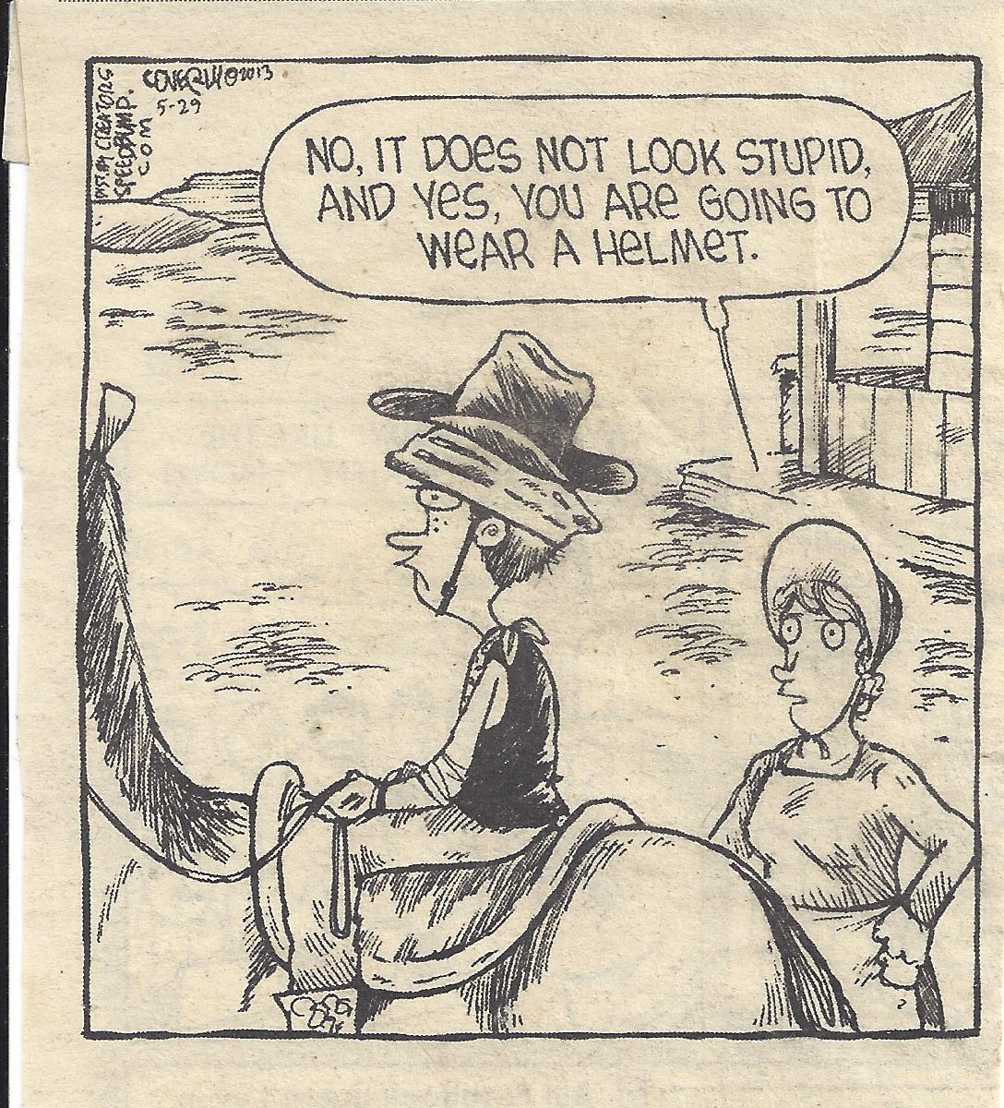
HELMETS

Slide 33
Helmet Use
Everyone who rides a horse at KFTHC must wear an ASTM/SEI equestrian helmet helmet while riding.
The helmet should fit comfortably but snugly with the straps making triangles around the ears and fastening with a snap under the chin.

Slide 34
General Safety Guidelines
Always walk , not run, around the horses.
Talk softly when approaching the horses so they know you are coming..
Do not feed the horses without authorization.
Never offer the horses food from your hands.
Do not pet or bother resting horses.
Do not let horses graze during sessions.

Slide 35
General Safety Guidelines continued:
Unauthorized persons should not enter occupied stalls or paddocks.
Stalls should not be cleaned with horses inside.
Do not leave stall cleaning tools in stalls, walkways or in the driveway of the barn.
Lock the gates when leaving the barn.
Always tie horses with a quick release knot.

Slide 36
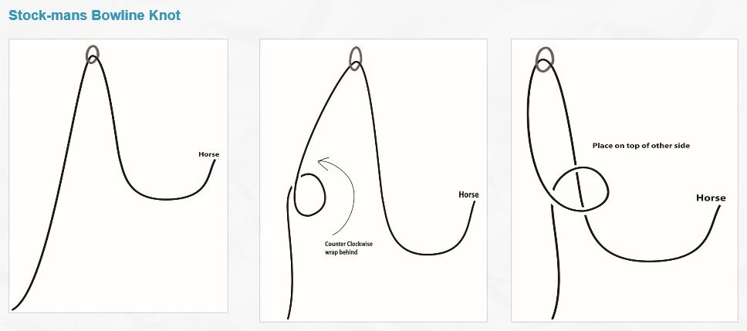
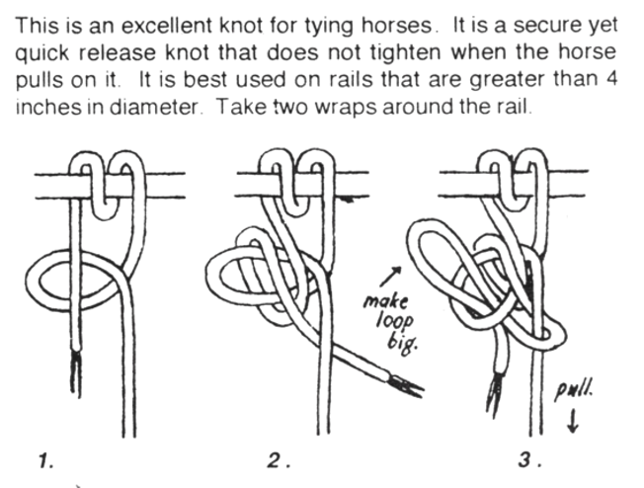
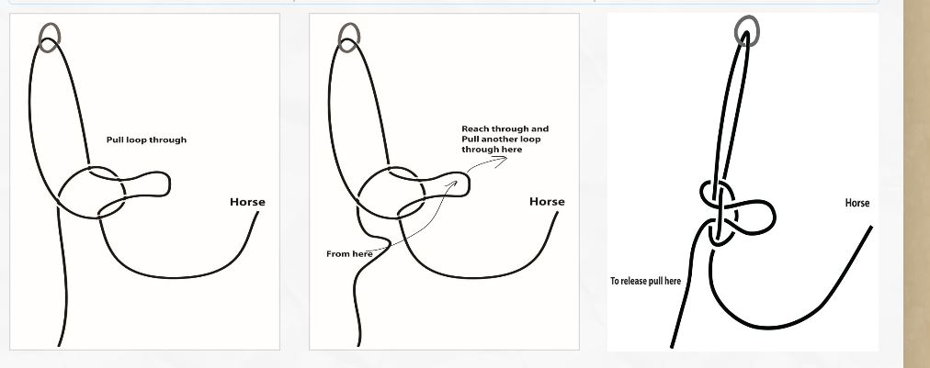

Slide 37
General Safety Guidelines continued:
NEVER tie up horses by their bits. Avoid leading horses by their bits.
Allow horses to become familiar with any new or strange object slowly and from many angles.
No dogs are permitted other than support dogs.
Everyone must wear a helmet when riding.
No smoking in KFTHC areas unless marked as a smoking area.

Slide 38
General Emergency Procedures/Policies
The instructor takes charge of the rider and stabilizes the situation as soon as possible. This may mean removing other riders and horses from the area.
The Leader will take charge of the horse and remove him from the area.
Sidewalkers will stay with their rider.
First Aid, if needed, will be administered by personnel with current CPR and First Aid Training.
Universal Precautions should be followed if body fluids are involved. All necessary protective equipment is in the First Aid Kits.
Call emergency numbers as needed.
If the emergency involves the health or behavior of the horse it is the leader’s responsibility to inform the instructor. The instructor will dismount the rider (unless an emergency dismount has already taken place) and the leader will remove the equine from the arena if possible.
At all times remain calm and in control.

Slide 39
Fire Plan
WE MUST ACT CALMLY AND QUICKLY IN CASE OF FIRE.
BEFORE YOU NEED TO, KNOW THE LOCATION OF AVAILABLE FIRE EXTINGUISHERS, EXITS AND RALLY POINTS.
EVACUATE PEOPLE FIRST THEN HORSES.
FOLLOW POSTED FIRE EVACUATION PLANS TO RALLY POINTS.
CALL 911
Remember, Emergency drills are an important part of KFTHC’s readiness plan. Be prepared.

Slide 40
More about Universal Precautions
Universal precautions involves the use of safety equipment when dealing with situations in which blood or bodily fluids are involved.
Safety equipment includes;
  LATEX OR NITRILE GLOVES
  CPR SHIELD
  Hand washing is an integral part or keeping yourself safe from contamination.

Slide 41
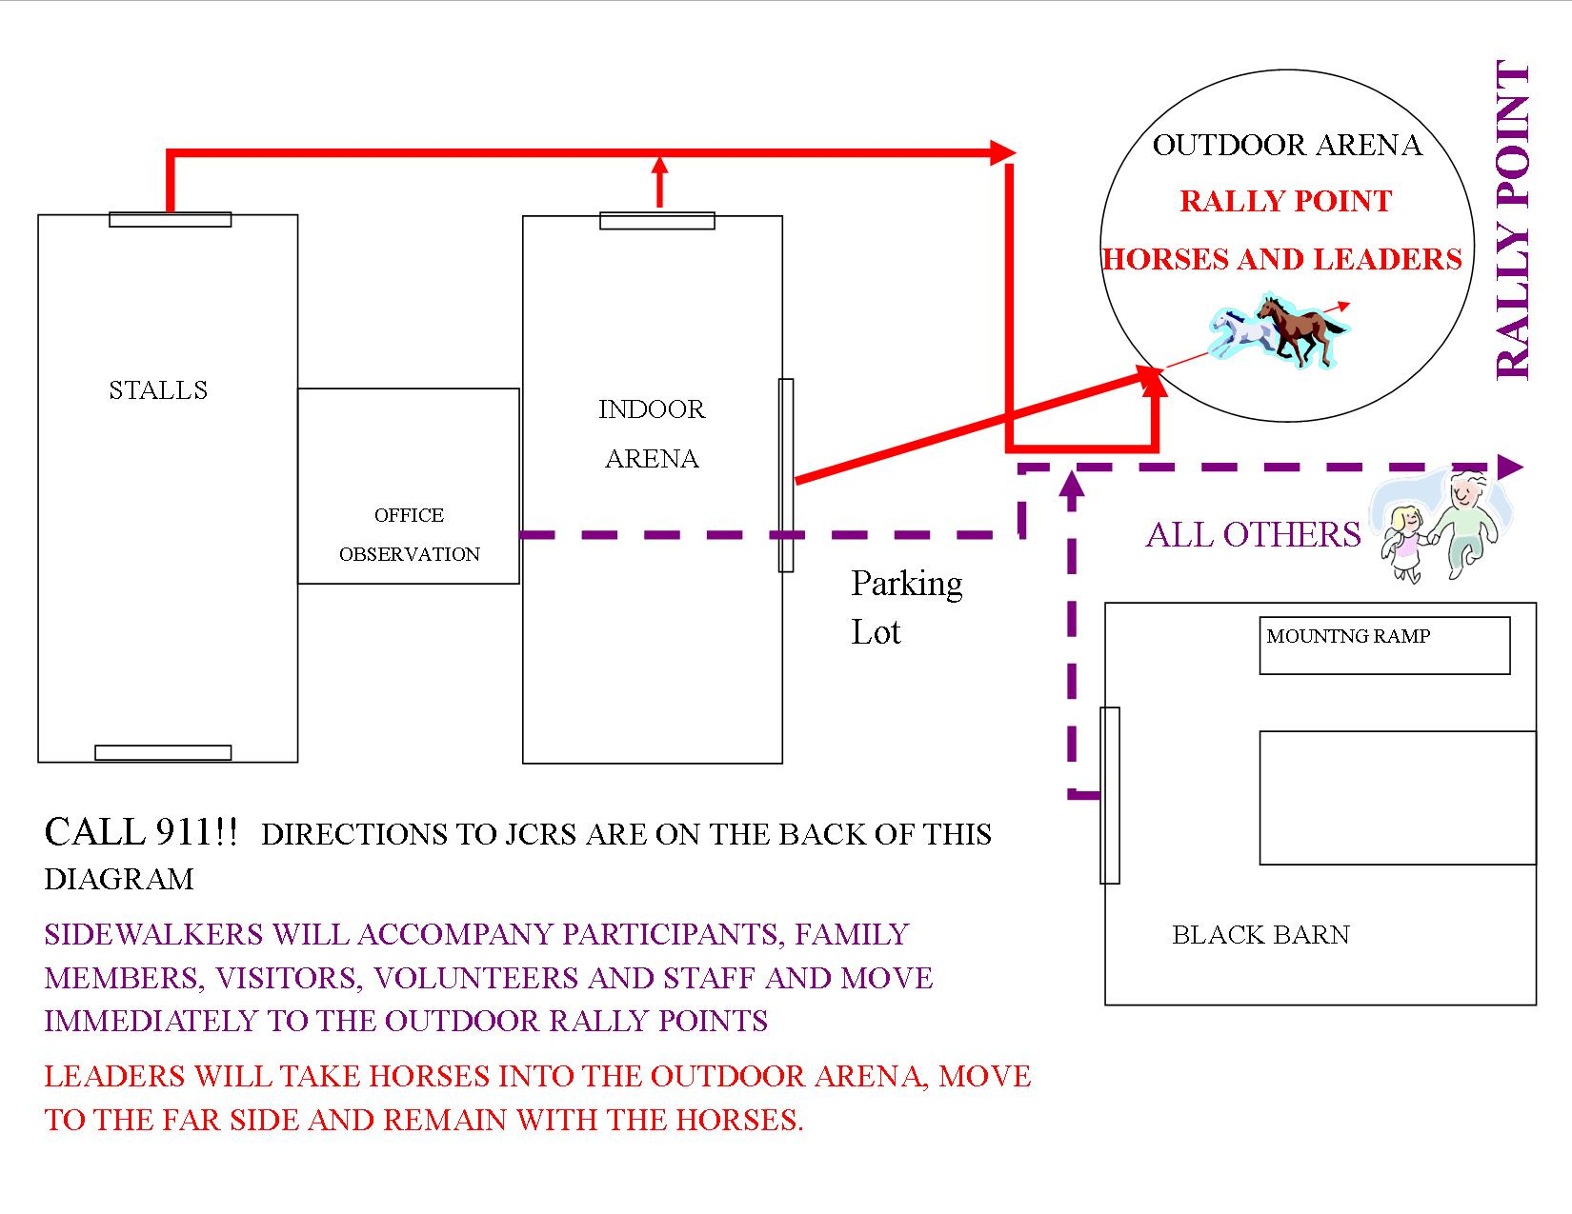
FIRE PLAN FOR JACKS CREEK RIDING CENTER

Slide 42
Tornados
If a tornado warning has been issued for Madison County it is likely that classes for the day will be cancelled. Call to confirm.
If a tornado is spotted without warning riders will be dismounted and removed to the Tornado Safe Room in the black barn to the south.
Horses will be evacuated from structures and turned out into the outdoor arena.
Everyone will remain in designated safe areas until the all clear is given by the instructor or other emergency personnel.

Slide 43
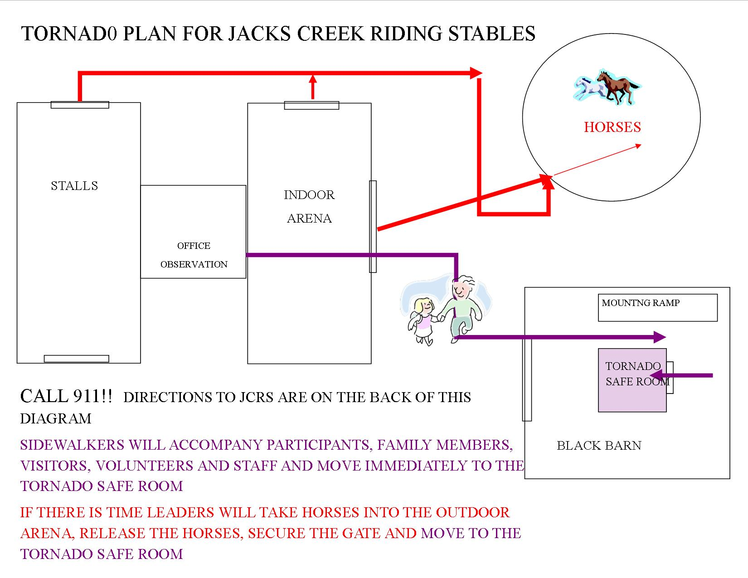

Slide 44
Electrical Storms
(If riding out of doors.)
At the first sound of thunder the instructor will call a line up and halt.
The instructor will dismount the riders.
Riders will leave the arena and move to a safe location.
Leaders will take the horses to a safe location and wait for further instructions.

Slide 45
Heat and Humidity
In summer months sessions will occasionally be cancelled because of a high heat index.
If the heat index is 95 degrees or higher sessions will be cancelled due to the danger of heat exhaustion or heat stroke to the riders, volunteers and horses.
On hot days during lessons, water and cool towels will be available.

Slide 46
Horse Care for Extreme Heat
If a horse is noticed to be in distress with elevated respiration and body temperature remember that the best thing to do is get the horse into a cool shaded area and run cool water directly onto the horse’s body.
The areas under the throat and on the chest are good areas for fast cooling.
Ice may also be applied.
When the horse feels cool to the touch, scrape off the water and place him in his stall with a fan to keep him cool. Regular checks should be made for an hour.
Do not feed or water an overheated horse without authorization from the Head Wrangler.
If the horse does not respond quickly to the above procedures call one of the vets whose numbers are posted.

Slide 47
RIDER WEIGHT POLICY
KFTHC will adhere to the following guidelines when making decisions regarding rider weight. Each guideline is in place so that every member of the team (horse, rider and volunteer) may have a safe experience. Horse health, a rider’s weight distribution, a rider’s ability to dismount without hurting the horse and each volunteer’s ability to safely assist a rider are all very important considerations.
Each horse will be evaluated as an individual and assigned a maximum carrying weight. Considerations will be made to age and health/soundness.
Each rider will be evaluated as an individual. Considerations will be made for the rider’s height, range of motion, balance and ability to dismount independently.
Each team will be evaluated to ensure that an appropriate volunteer/instructor is available to complete all emergency procedures including an emergency dismount.
In general, the following rider height to weight ratios will be followed.
RIDER HEIGHT MAXIMUM WEIGHT
Under 5’ tall 150 lbs
5’ TO 5’6” ta;;1 175 lbs
5’7” to 6’ tall 200 lbs
6’1” to 6’5” tall 250 lbs
The maximum amount of weight each horse can carry is determined using the following formula:
20% of the horse’s weight minus the weight of tack minus 10 lbs for degrees of unbalanced rider movement. (Unbalanced rider movement is determined through instructor observation while rider is mounted and through a balance exam while non-mounted.) Other considerations are observation of equine movement while carrying weight and veterinary input.
Rider Height | Maximum weight
Under 5’0” tall | 150 lbs.
5’ to 5’6” tall | 175 lbs.
5’7” to 6’ tall | 200 lbs
6’1” to 6’5” tall | 250 lbs

Slide 48
Horse Health Emergency
Examples of such emergencies may include: Lameness, Colic, Unusual Behavior…
If this happens during a lesson:
The instructor will call to “Whoa” all horses and dismount the effected rider in the center of the arena.
The sidewalkers will accompany the rider out of the arena.
The leader will take the horse to a safe area and notify the Head Wrangler.
The lesson will resume with the remaining riders, horses and support personnel.
If the horse’s condition is serious, the Head Wrangler or other designated person will call the Vet (numbers are posted). Other persons will remain away from the area in which the horse is being treated.

Slide 49
Safety Around Horses
Horses are large and powerful. You can be badly hurt if you are inattentive or careless when working with horses or being around them.
Imagine that a horse has a 6 foot danger zone surrounding him. Within this zone a horse can kick, strike or bite. Approach with caution.
Speak softly as you approach a horse to let him know you are coming.

Slide 50
Don’t yell, run or make sudden movements near a horse. Be slow and gentle.
Speak softly as you approach a horse to let him know you’re coming.
Approach a horse from the side whenever possible. A horse cannot see what is directly in front or behind him.
When standing next to a horse, stand very close. If the horse kicks, he can’t kick very hard if you are close.

Slide 51
If you must walk behind a horse, speak softly and touch the horse on the shoulder. Keep your hand on him and stay close as you move.
Never walk under the horse’s neck. Never walk under a horse. You may not be that short, but some children are.
It’s easy to get your feet stepped on so be aware of where your feet are in relation to your horse’s hooves.
Hand feeding is an invitation to have your fingers bitten. Keep your hands away from the horse’s mouth.

Slide 52
Keep horses well away from one another at all times. Fighting horses are a danger to each other and to anyone nearby. Keep eyes on heads and rear ends. If ears are flattened (pinned) the horse is warning you he is about to fight. If he lifts a leg he may be getting ready to kick.
If a tied horse rears or pulls back, or otherwise acts upset, stay away. Let the instructor or Head Wrangler handle the problem. A panicked horse is very dangerous.

Slide 53
Stewardship
KFTHC is a non-profit agency. All materials and equipment are provided by or through donations from others.
It is, therefore, important to practice good stewardship.
Good stewardship involves proper maintenance, cleaning, storage and repair of materials and equipment.

Slide 54
Stewardship, continued
Good stewardship also involves reducing, recycling and reusing.
KFTHC makes an effort to recycle all appropriate materials including- but not limited to- plastics, paper, glass, cardboard and aluminum and steel cans.
Please help us in this effort.
Please consider recycling in your own home and workplace.

Slide 55
Introduction to Equine Assisted Activities and Therapies (EAAT)
EAAT uses horses, ponies or mules for the purpose of contributing positively to the cognitive, physical, emotional and social well-being of people with disabilities.
The following classifications reflect the primary fields of EAAT and their different approaches. An integrated approach uses the therapeutic benefits in all four fields, however each can be practiced as a specialty.

Slide 56
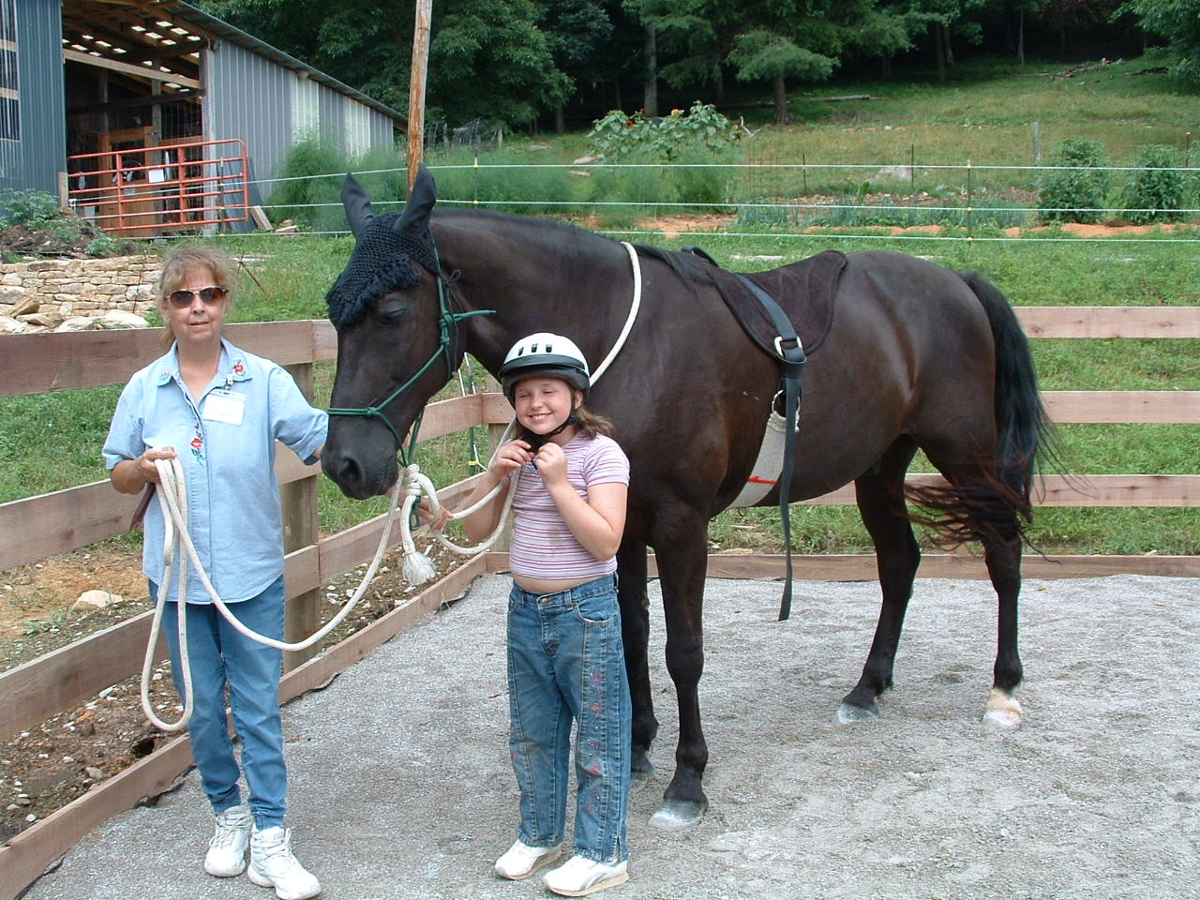

Slide 57
INTRODUCTION TO EQUINE ASSISTED ACTIVITIES AND THERAPIES

Slide 58
Therapy
Equine activities are used as a form of therapy to achieve physical, psychological, cognitive, behavioral and communication goals.
Health professions including physical therapy, occupational therapy, speech therapy and psychology have specialized forms of treatment using the horse within their professions.
These include, but are not limited to, Classic Hippotherapy, Hippotherapy, Developmental Riding Therapy, and Equine Assisted Psychotherapy

Slide 59
Equine Assisted Learning (EAL)
Equine Assisted Psychotherapy (EAP)
The emphasis is to incorporate cognitive, behavioral, psychological and physical goals into the program plan while teaching adaptive riding, driving or vaulting.
Therapeutic riding instructors, educational specialists and health professionals are involved in the design and implementation of these programs.

Slide 60
Sport
Activities are directed toward the acquisition of skills leading to the accomplishment of specific horsemanship goals.
Therapeutic riding instructors are primarily responsible for the design and implementation of the program.

Slide 61
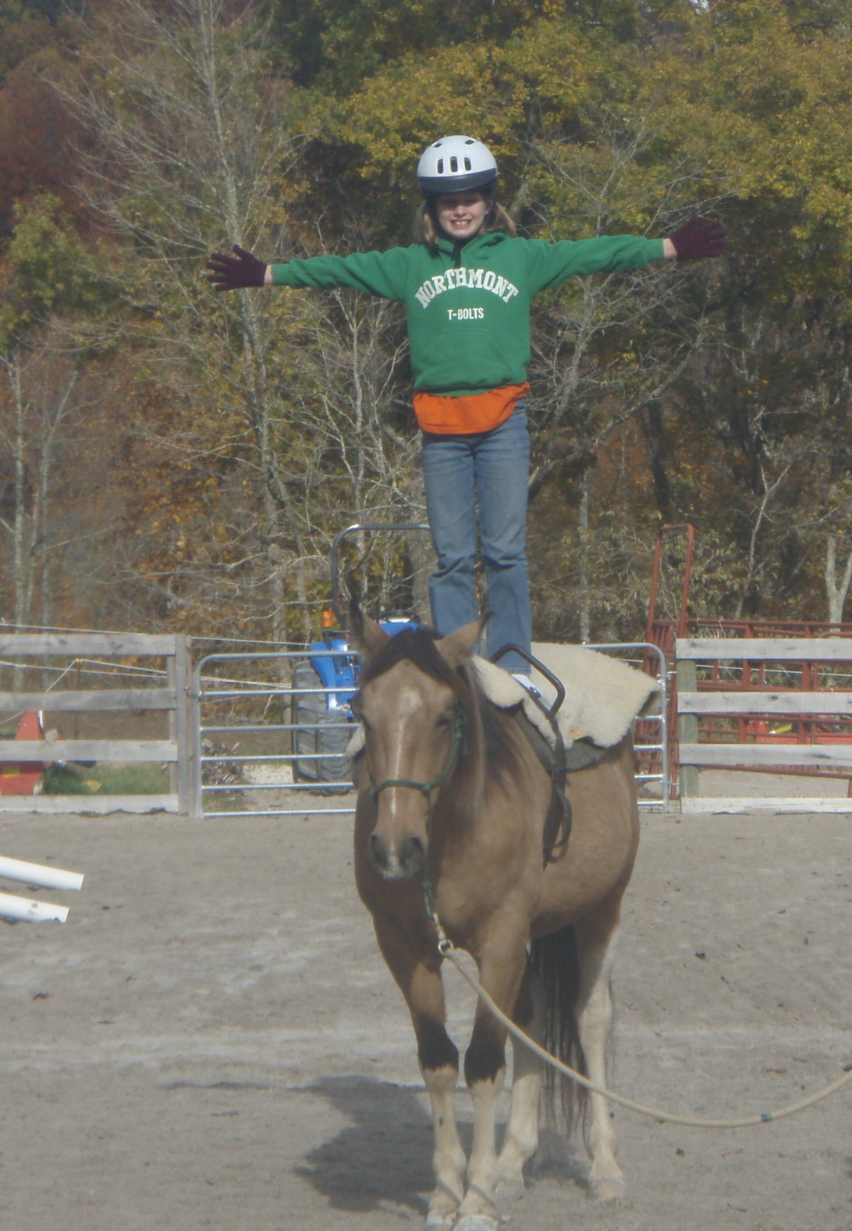

Slide 62
Recreation and Leisure
The emphasis is on an enjoyable, relaxing experience that provides additional therapeutic benefits in the area of socialization, posture, mobility and an overall improved quality of life.
Individuals may participate in horse-related activities to their maximum ability in an atmosphere of support, structure and socialization for the primary purpose of the intrinsic enjoyment of the activity.
Therapeutic riding instructors and recreational therapists are primarily responsible for program development. Health professionals and educational specialists are involved on a consultative basis.

Slide 63
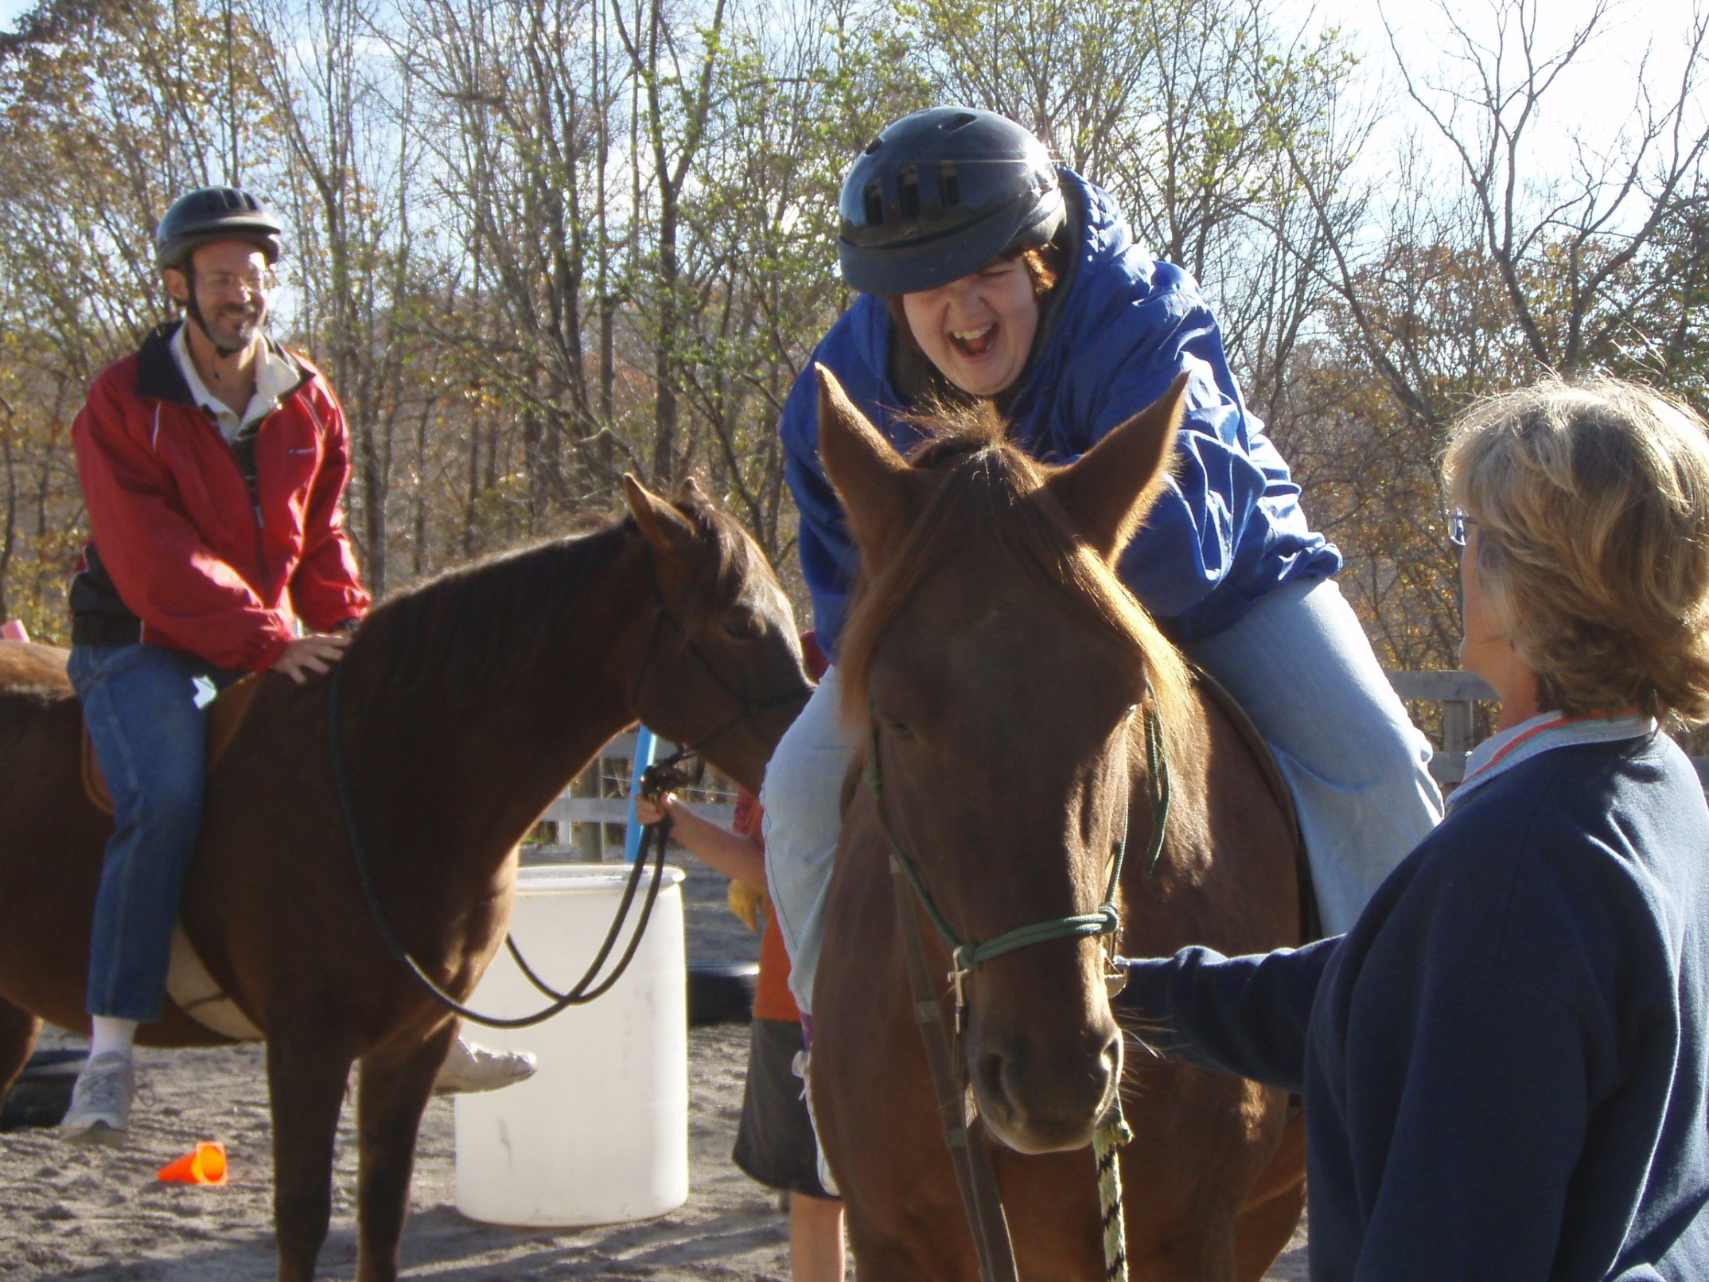

Slide 64
Hippotherapy (HPOT)
Hippotherapy is a direct medical treatment.
Medical professionals, primarily physical and occupational therapists use this treatment for their clients who have movement dysfunction.

Slide 65
Equine Services for Heroes
Equine Services for Heroes was developed by PATH Intl. and is a program of Equine Assisted Activities and Therapies (EAAT) for veterans and active duty soldiers.
EAAT have been found helpful in assisting wounded warriors reconnect with their families and communities and to rise above psychological and physical challenges through the age-old relationship between horse and human.
Participants are supported by volunteers as needed. Volunteers support riders through horse management and through encouragement and facilitation with activities.
It has been proven that military helping military is an additional benefit of the program. Everyone benefits from this experience.

Slide 66
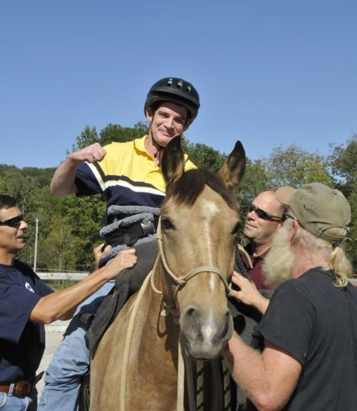

Slide 67
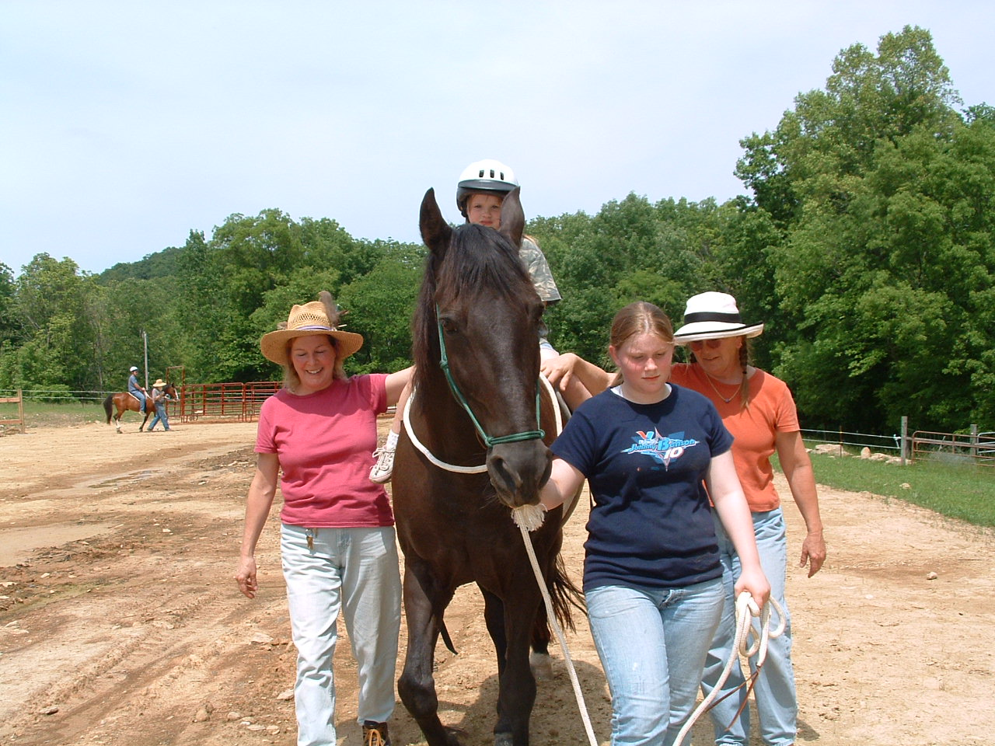
The Support Team

Slide 68
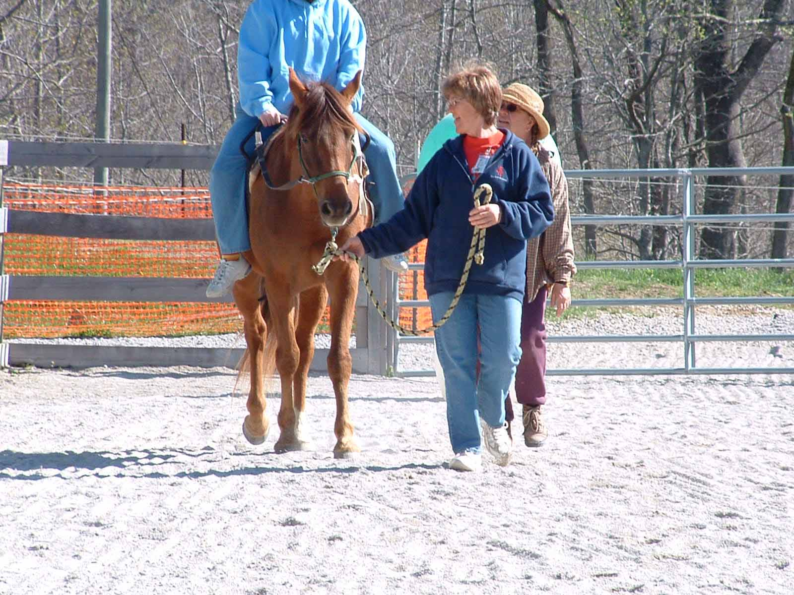
The Role of the Leader

Slide 69
The Leader
A leader’s first responsibility is the horse but she must also be aware of:
The Rider
  The leader should reinforce the Rider’s attempts to control the horse but allow time for the rider to process the instruction.
The Instructor
  Listen for directions from the Instructor.
The Sidewalkers
  Make sure there is enough room and help them be aware of possible obstacles.
Any possible hazards in the arena
  Footing
  Elevation changes

Slide 70
Leader Qualifications
Demonstrate a strong understanding of and experience with horse handling.
Minimum age of 14.
Walk and jog on possibly uneven surfaces with the horse for the duration of the lesson.
Adequate vision and hearing to ensure safety of horses and participants.
Ability to “read” a horse and the knowledge and confidence to calmly prevent unexpected movements.
Ability to adapt to change, be flexible and patient.

Slide 71
Leader Responsibilities
Commitment to attend your scheduled lessons.
Ensure the horse is warming up in the arena 10 minutes prior to the lesson.
Initial tack check before mounting.
Remain focused on the horse at all times during the lesson to ensure safety, to keep the horse calm and to anticipate any unforeseen situations.
Lead the horse in class. Give guidance to the horse from the rider’s cues if necessary.
Listen to the directions of the instructor.
Untack and ‘rest’ the horse after the class.

Slide 72
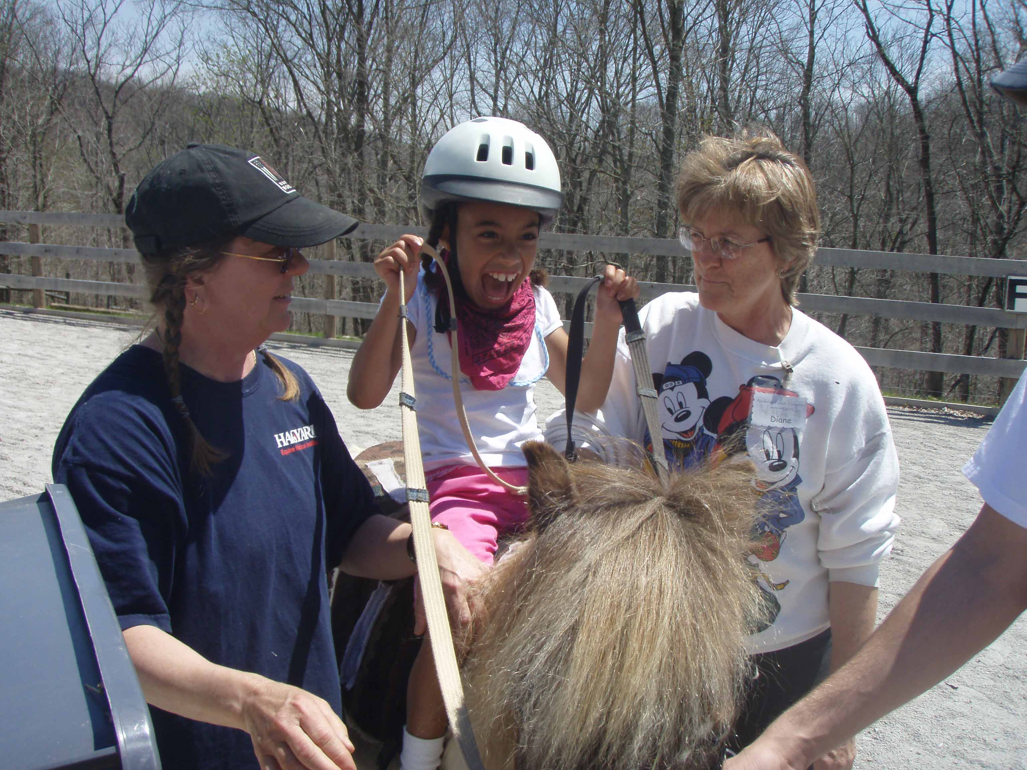
The Role of the Sidewalkers

Slide 73
Effective Sidewalking
Sidewalkers are directly responsible for the safety and support of the rider.
Sidewalkers should help the rider focus on the instructor.
Allow the rider plenty of time to process the instruction.
Avoid unnecessary conversation, too much input can be confusing to everyone.
Reinforce the Instructor’s directions. Use Hand-Over-Hand Assistance if necessary.
Maintain a position by the rider’s knee.
Hold the rider without interfering. The Instructor will suggest the proper hold.

Slide 74
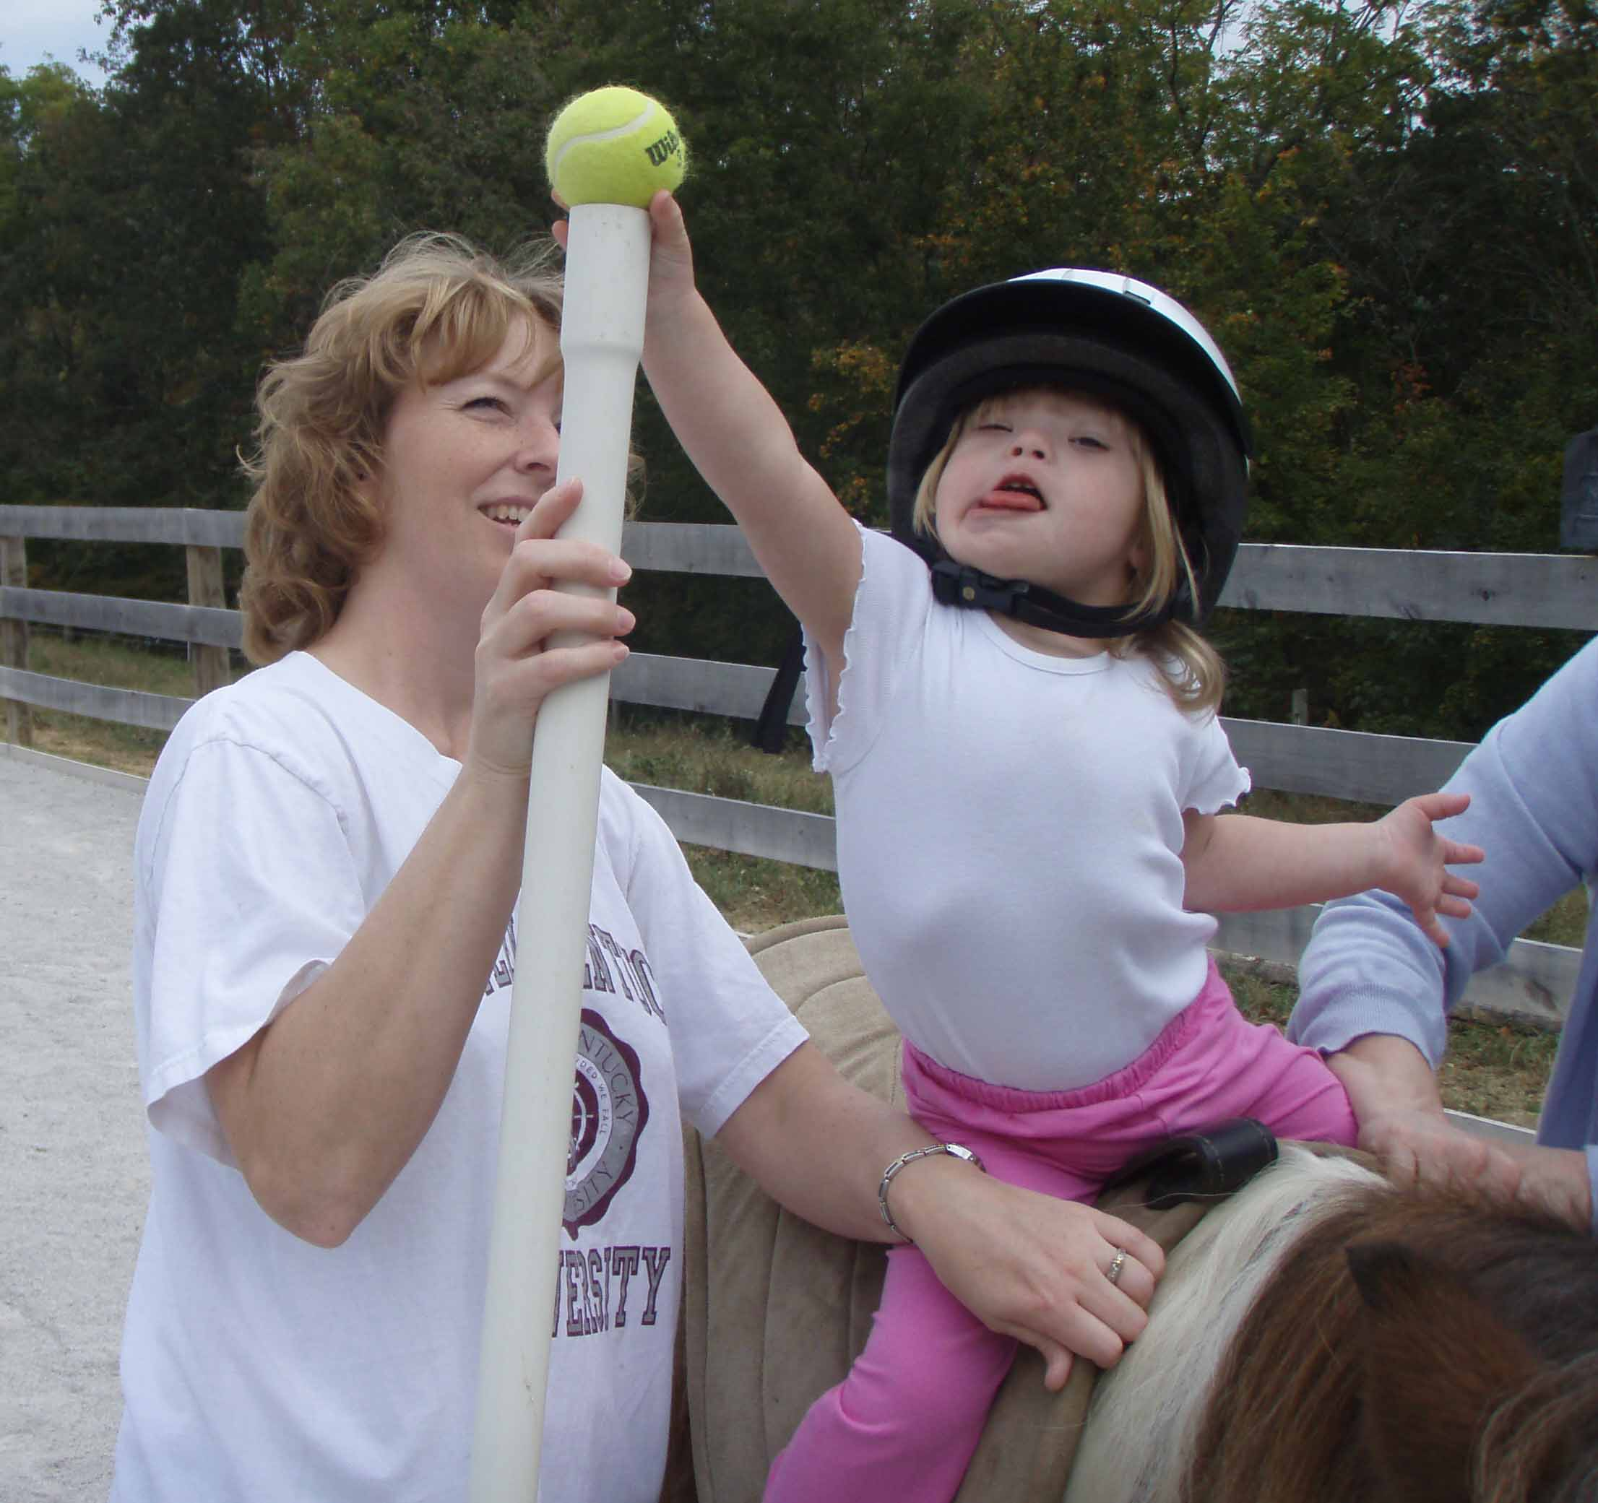
Arm Over the Thigh

Slide 75
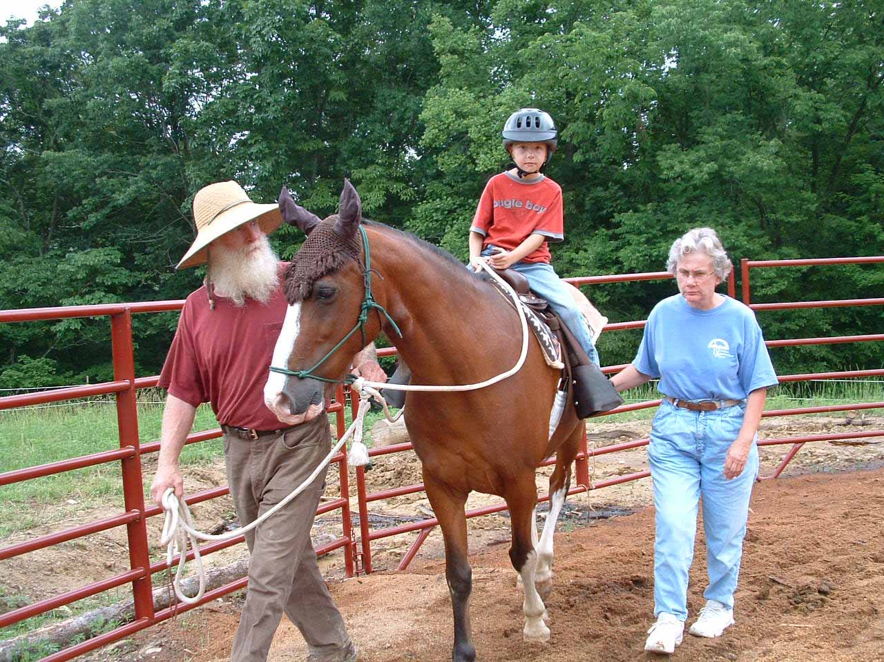
Ankle Hold

Slide 76
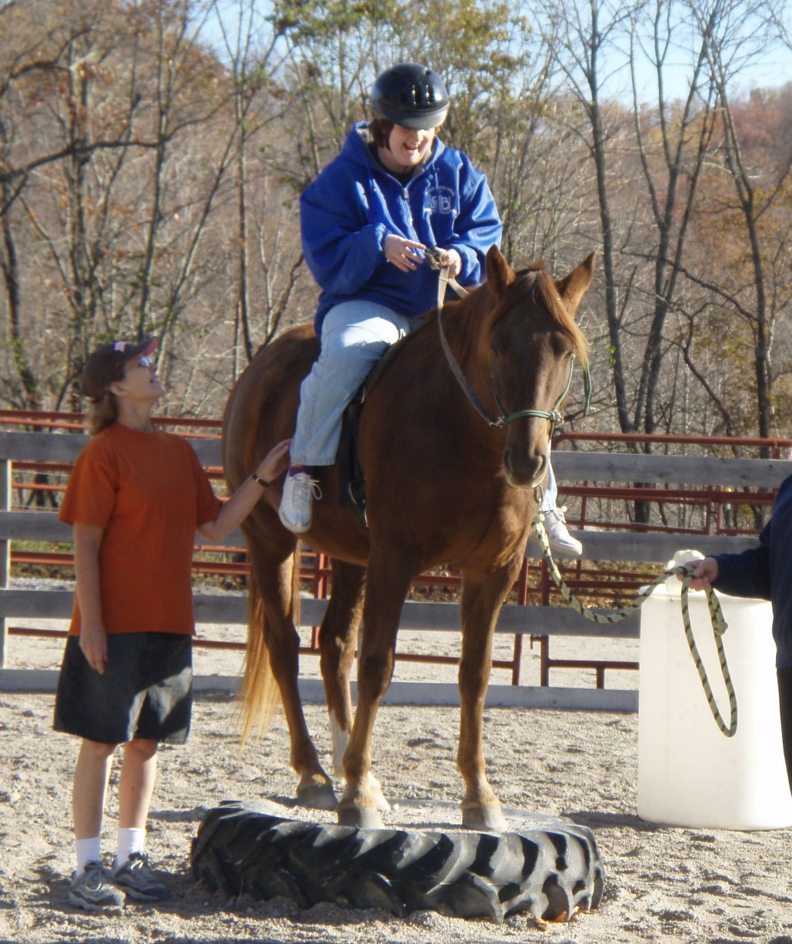
Walk Along/ Floater

Slide 77
Sidewalker Qualifications
Walk and occasionally jog alongside the horse for the duration of the lesson on possibly uneven surfaces.
Ability to hold your arm, slightly raised and out to the side for up to 30 minutes, providing support to the rider as necessary.
Adequate vision to ensure the safety of the rider.
Ability to adapt to change, be flexible and patient.
Comfortable working with horses and children and/or adults with disabilities and special needs (including physical contact).
Minimum age is 14 or with Program Manager approval.

Slide 78
Sidewalker Responsibilities
Commitment to attend your scheduled lessons.
Assist rider with correct fitting of helmet.
Assist with supporting rider during mounting/dismounting.
“Bridge” the instructions to the rider. Repeat directions, redirect attention, Cheer, Encourage and Praise.

Slide 79
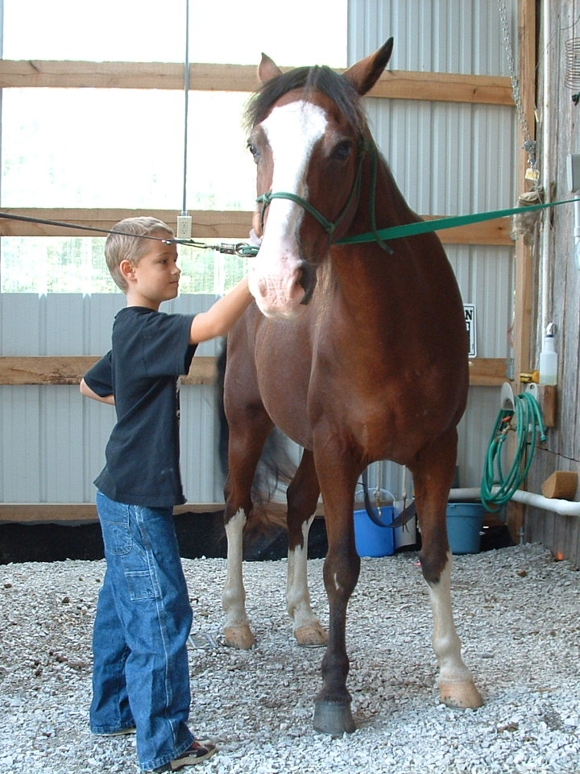
Wranglers
The Wranglers are the “behind the scenes” volunteers involved in horse care, feeding, training, and preparing the horses for EAAT.

Slide 80
Wrangler Qualifications
Ability to adapt to change, be flexible and patient.
Horse handling experience preferred.
Minimum age of 12 or with Program Director approval
Can not be fearful of horses.

Slide 81
Wrangler Responsibilities
Commitment to attend to your scheduled duties.
Leading horses from and to pasture, feeding, grooming and tacking.
Evening turn-out.
Chores such as haying, stall cleaning, cob webbing, tack cleaning.
Report to the Head Wrangler, Mark Martin.

Slide 82
Instructor
The Instructor is responsible for planning for, setting up for and teaching the classes.
She/He is not only to teach horsemanship skills and riding but it is also the Instructor’s job to ensure the safety of those students who are participating in the classes.
This person should have passed the PATH, Intl. standards for Registered Instructor or above.

Slide 83
Volunteer Coordinator
The responsibilities of KFTHC’s Volunteer Coordinator are to schedule volunteers for riding sessions and other activities.
When possible the Volunteer Coordinator will use email contact to schedule volunteers.
It is appropriate for eager volunteers to contact the Volunteer Coordinator to advise him/her of availability.
KFTHC’s current Volunteer Coordinator is Louise Locke.

Slide 84
Hay Crew
Hay Crew members are those volunteers who will be available on a rotating basis to help with horse care at Jacks Creek Riding Stables or at Woods Point Farm.
Hay Crew members will be supervised by the Head Wrangler, Program Director or Executive Director.
If you are interested in becoming a Hay Crew member, speak to Mark, Cheryl, Chelsea or Karen.

Slide 85
Hay Crew Qualifications
Attendance at KFTHC Volunteer Orientation.
Successful completion of Hay Crew Training.
Previous horse experience is required.
Ability to have reliable, on-time attendance.
Will feed hay, grain and supplements.
Clean and fill water buckets and troughs.
Check horses for illness and injury.
Bring horses in and out of barn as needed.
Clean and prepare stalls for horse occupancy.
Put on or take off muzzles, fly masks and blankets as needed.
Clean and put away feed pans, buckets, rakes, muck tubs and other tools used.
Rake barn aisle.
Assist in maintaining a clean and orderly feed area.

Slide 86
Disabilities Awareness
“We are obliged to respect, defend and maintain the common bonds of union and fellowship that exist among all members of the human race.”
Cicero 106 BCE-43 BCE

Slide 87
Person-First Language
Refer to the person first rather than the disability.
“Person First” language says that we believe in and value individualized, people-oriented supports and services.
Person-First language is respectful and considerate.

Slide 88
Labels as Stereotypes
Labels:
Define people’s lives.
Limit what we expect the person to achieve.
Don’t allow opportunities for growth and inclusive lifestyles.
Devalue and depersonalize individuals.
Make it appear that an intellectual disability is a sickness or disease.

Slide 89
General Information About Disabilities
Congenital- presented at or before birth.
Acquired- presented after birth.
Progressive- gets worse over time.

Slide 90
Presenting Conditions
Might Effect:
Mobility
Muscle Tone
  Hypertonic
  Hypotonic
  Fluctuating
Endurance
Strength
Flexibility
Bilateral Coordination
Stability

Slide 91
Presenting Conditions
Might Include:
Pain
Deformity
Low Self-Esteem
Sensory Integration Disorder
Anxiety

Slide 92
Getting to Know the Person with Special Needs

Slide 93
General Approach and Interaction
It is important to remember that every child or adult is an individual and wants to be treated with that understanding regardless of having a disability or not. Each has his/her own style of learning, unique personality and temperament. One must always look beyond the disability into the person. Provide each participant with an enriched experience with warmth and a favorable environment in which to learn and grow. All people, disabled or not, want to feel that they are not all that different from the rest of their peers.

Slide 94
SUGGESTIONS TO HELP YOU RELATE TO A PERSON WITH A DISABILITY.
Be yourself.
Relax.
Speak directly to the person with the disability. Your attention should be on him and not the person escorting him.
If a person has difficulty speaking, allow her to finish her sentence. If you don’t understand what’s being said, tell her so. Don’t pretend you understand if you don’t.
Use conversation and behavior that you would use in any situation.
Offer assistance when asked or when the situation obviously requires it.
Be sensitive to separating a rider from his wheelchair, crutches, or braces uness asked. Never move any mobility aid unless asked to.
Respect the person’s right to independence and her request for the type of assistance she requires.
Be guided by the wishes of the person with a disability. Talk about the disability if it comes up naturally, but don’t pry.
Appreciate what the rider can do. Remember that the difficulties a person might be facing could stem from society’s attitudes and barriers rather than the disability itself. People with disabilities generally do not view themselves to be as handicapped as society perceives them to be.
Be patient.
Let the person set the pace in walking and talking.
Communicate with your heart and see each person from his/her heart.
.
Acknowledge that every person has the opportunity for vast potential in his life. Share the feeling that each person’s potential is found in the present moment.
Source: Healing Reins Therapeutic Riding Center
Notes:
Relax- let the person with the disability put you at ease if you do not know what to say.
Do not overwhelm the person with help or insist on helping when he is managing alone. When a person is trying to increase their physical ability, effort on their part is necessary.
Be patient- Be considerate of the extra time it might take a person with a disability to accomplish something or respond to something.

Slide 95
OUR COMPLEX SENSORY PROCESSING SYSTEMS

Slide 96
Our Five Sensory Systems
Auditory- the sense of hearing
Visual- the sense of sight
Gustatory- the sense of taste
Olfactory- the sense of smell
Tactile- the sense of touch

Slide 97
And Three More
Visceral
Vestibular
Proprioceptive

Slide 98
Sensory Integration
The process by which the brain organizes sensory information for appropriate use.
The process of organizing sensory inputs so that the brain produces a useful body response and also useful perceptions, emotions and thoughts.

Slide 99
Disorders of Sensory Integration include
Gravitational Insecurity
Hyper- or Hypo- sensitivity to Movement
Developmental Dyspraxia
Tactile Defensiveness
Notes:
An individual with gravitational insecurity does not trust his perception of where he is in space. A person with a vision impairment may have G.I. since they have no visual reference of their position in space, but persons with S.I. dysfunction may have accurate vision and yet a fear of heights or open spaces.
Hyper- means ‘over’, Hypo- means ‘under’ – an individual with sensitivity to movement may fear even small amounts of movement or not register the same amount of movement another individual might.
Developmental Dyspraxia means that the individual’s brain knows what it wants the body to do but it just can’t communicate that to the body.
Tactile defensiveness involves the feeling of touch all over the body. Persons with TD may not like to be touched or they may not like to touch certain things.

Slide 100
Sensory Integration Dysfunction:
Benefits of Therapeutic Riding
TR combines Vestibular, Proprioceptive and Tactile inputs.
Slow Vestibular input can be calming.
Vestibular input can effect muscle tone.
TR gives the opportunity to move in all planes.
Joint compression, which occurs during TR, assists in modulating vestibular input.
Tactile input provides a calming, focusing, organizing reaction.
Movement “drives” language.

Slide 101
Disabilities At A Glance

Slide 102
Arthritis
An inflammatory disease of the joints
Types- Osteo, Rheumatoid, Juvenile Rheumatoid.
Characteristics- Pain, lack of mobility, deformity, loss of strength.
Benefits (of Therapeutic Riding)- General rhythmic movement to promote joint mobility and relieve pain.

Slide 103
Autism Spectrum Disorder (ASD)
A developmental disability that typically appears during the first three years of life, affecting a child’s development.
Autism affects all aspects of an individual’s life.
Autism affects how an individual thinks, communicates and interacts with others.
Autism occurs in approximately 1 in 80 individuals.

Slide 104
Autism Spectrum Disorder
Is NOT:
A mental illness.
The result of bad parenting.
Unruly individuals who choose not to behave.
Always associated with mental impairment.
Always associated with behavioral challenges.
The same in every individual.

Slide 105
Autism Spectrum Disorder
Characteristics may include:
Unresponsiveness to the presence of others.
Withdrawal from physical contact.
Delayed or disordered language.
Self-stimulating behaviors.
Unawareness of danger.
Ritualistic behaviors.
Resistance to change.

Slide 106
ASD
Benefits of Therapeutic Riding (TR) and Equine Assisted Activities and Therapies (EAAT)
Can improve attention span.
Can improve sensory processing.
Can improve social functioning.
Can improve communication skills.

Slide 107
Cerebral Palsy
Brain damage occurring before, at or shortly after birth. It is a non-progressive motor disorder.
Characteristics- Hypertonicity, hypotonicity, muscle imbalances, increased startle response, slow and deliberate speech, difficulty with fine motor skills.
Benefits- Normalization of tone, stimulation of postural and balance mechanisms, muscle strengthening and perceptual motor coordination.
Associated problems- Seizures, hearing impairments, vision impairment, sensory integration disorders, perceptual problems.

Slide 108
Cerebral Vascular Accident- Stroke
A hemorrhage or blockage in the brain which causes various degrees of functional impairment.
Characteristics- Flaccid or spastic paralysis of limbs. May impair oral-motor function, sight, balance, posture, coordination and strength.
Benefits- TR promotes symmetry, stimulates balance, improves posture, motor planning, speech and provides opportunities for socialization.

Slide 109
Down Syndrome
A condition in which the person is born with an extra chromosome, resulting in developmental delay.
Characteristics- Individuals are usually hypotonic, have hyper-mobile joints, and are prone to respiratory infections.
Benefits- TR improves muscle tone, expressive and receptive communication skills, gross and fine motor skills, balance and coordination.

Slide 110
Emotional Disabilities
A congenital or acquired condition often compounded by learning and/or physical disabilities incorporating numerous other pathologies.
Characteristics- Trouble coping with everyday life situations and interpersonal relations.
Behaviors such as short attention span, avoidance, aggression, paranoia, and schizophrenia may be exhibited.
Benefits- EAAT increases feelings of self-confidence, and self-awareness and provides an appropriate social outlet.

Slide 111
Epilepsy/Seizure Disorder
Abnormal electrical energy in the brain marked by seizures and altered consciousness.
Types and characteristics-
  Petit Mal/Absence Seizures- usually last 10-20 seconds. They begin and end suddenly. During the seizure, awareness and responsiveness are impaired.
  Grand mal/Tonic-clonic- Loss of consciousness with loss of postural tone.
  Note- An active seizure disorder is a contra-indication for horseback riding. However these individuals can participate in other forms of EAAT.

Slide 112
Fetal Alcohol Syndrome (FAS)
Fetal alcohol syndrome is a condition in an individual that results from alcohol exposure during the mother's pregnancy. Fetal alcohol syndrome causes brain damage and growth problems. The problems caused by fetal alcohol syndrome vary from person to person, but defects caused by fetal alcohol syndrome are irreversible.
There is no amount of alcohol that's known to be safe to consume during pregnancy. If you drink during pregnancy, you place your baby at risk of fetal alcohol syndrome.

Slide 113
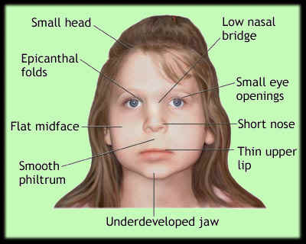
Fetal Alcohol Syndrome
Physical defects
Physical defects may include:
Distinctive facial features, including wide-set eyes, an exceptionally thin upper lip, a short, upturned nose, and a smooth skin surface between the nose and upper lip.
Deformities of joints, limbs and fingers
Slow physical growth before and after birth
Vision difficulties or hearing problems
Small head circumference and brain size
Heart defects and problems with kidneys and bones

Slide 114
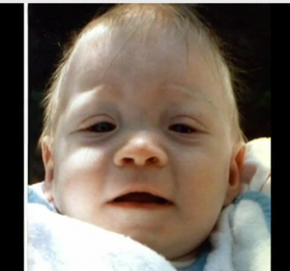
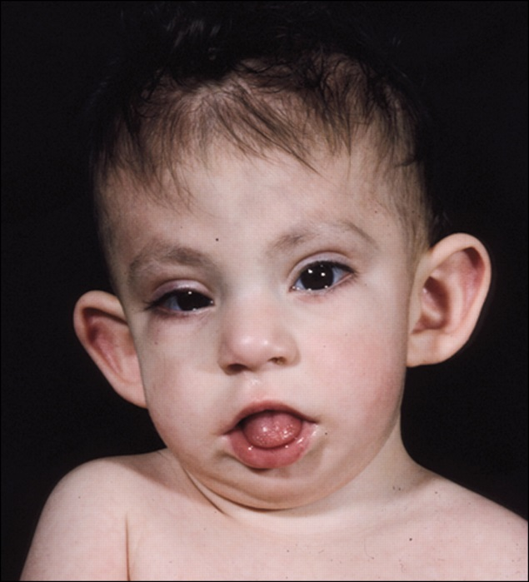
Fetal Alcohol Syndrome
The severity of fetal alcohol syndrome symptoms varies, with some children experiencing them to a far greater degree than others. Signs and symptoms of fetal alcohol syndrome may include any mix of physical defects, intellectual or cognitive disabilities, and problems functioning and coping with daily life.

Slide 115
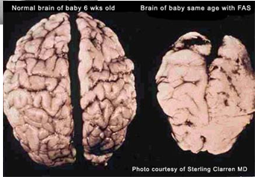
Fetal Alcohol Syndrome
Problems with the brain and central nervous system may include:
Poor coordination or balance
Intellectual disability, learning
disorders and delayed development
Poor memory
Trouble with attention and with processing information
Difficulty with reasoning and problem-solving
Difficulty identifying consequences of choices
Poor judgment skills
Jitteriness or hyperactivity
Rapidly changing moods

Slide 116
Fetal Alcohol Syndrome
Problems in functioning, coping and interacting with others may include:
Difficulty in school
Trouble getting along with others
Poor social skills
Trouble adapting to change or switching from one task to another
Problems with behavior and impulse control
Poor concept of time
Problems staying on task
Difficulty planning or working toward a goal

Slide 117
Fetal Alcohol Syndrome
Benefits of Therapeutic Horsemanship
Therapeutic horsemanship and EAAT
promote self-confidence, balance, posture and coordination.
stimulate attention span, increase time on task, improve group skills and improve problem-solving skills.
increase self-awareness and cooperation with others and provide an appropriate social outlet.

Slide 118
Hearing Impairment
Congenital or acquired hearing loss varying from mild to profound.
Characteristics- Communication difficulties- may use adaptive equipment, finger spelling, or lip reading.
Benefits- TR promotes self-confidence, balance, posture and coordination.

Slide 119
Learning Disabilities
A catch-all phrase for individuals having problems processing and sequencing information and problem solving.
Characteristics- Short attention span, easily frustrated, immaturity.
Benefits- TR and EAAT stimulate attention span, group skills, cooperation, language skills, posture and coordination.

Slide 120
Multiple Sclerosis (MS)
A progressive neurological disease with a degeneration of spinal column tracts resulting in scar formation.
Most commonly occurs in the 20-40 year old range. It is progressive with periods of exacerbations and remissions. Individuals are easily fatigued. Symptoms include weakness, visual impairments, fatigue, loss of coordination and emotional sensitivity.
Benefits: Maintains and strengthens weak muscles and provides opportunities for emotional therapy.

Slide 121
Muscular Dystrophy (MD)
Deficiency in muscle nutrition with degeneration of skeletal tissue. A hereditary disease which effects mostly males.
Characteristics: Progressive muscle weakness, fatigues easily, sensitive to temperature extremes.
Therapeutic riding provides opportunities for group activities, may slow progressive loss of strength, stimulates postural and trunk alignment and allows movement free of assistive devices.

Slide 122
Parkinson’s Disease
Symptoms of Parkinson’s disease differ from person to person. They also change as the disease progresses. Symptoms that one person gets in the early stages of the disease, another person may not get until later—or not at all.
Stiff muscles (rigidity) and aching muscles.
Slow, limited movement,
Weakness of face and throat muscles.
Difficulty with walking and balance.
Freezing- a sudden, brief inability to move. It most often affects walking.

Slide 123
Post Traumatic Stress (PTS)
Post-traumatic stress syndrome is a type of anxiety disorder. It can occur after a person has seen or experienced a traumatic event that involved the threat of injury or death.
PTS can occur at any age and can follow a natural disaster such as a flood or fire, or events such as war, a prison stay, assault, domestic abuse, or rape.

Slide 124
Post Traumatic Stress
Benefits of Equine Assisted Activities:
Increased self-confidence.
Renewed feelings of efficacy.
Improved self-concept.
Improved ability to read non-verbal communication.
Restoration or development of trust.
Reduction of anxiety.
Decreased isolation.
Improved impulse modulation.
An opportunity to be “in the moment”.

Slide 125
Spinal Cord Injury
Trauma to the spinal cord resulting in loss of neurological function.
Characteristics: Paralysis of muscles below the level of the injury. Fatigue, sensory loss and pressure sores.
Benefits: TR stimulates posture and balance, strengthens trunk muscles, provides an opportunity for sports participation and recreation.

Slide 126
Traumatic Brain Injury (TBI)
Injury to the head resulting in intra-cranial bleeding with death of brain cells.
Characteristics: Gross and Fine motor skills deficits. Often have impaired memory, speech, balance and/or vision. May have psychological effects.
Benefits: TR stimulates balance, posture, fine and gross motor skills, speech and perceptual skills.

Slide 127
Vision Impairment
Moderate to severe loss of sight.
Characteristics: Insecure posture, lack of visual memory, anterior center of gravity, fearfulness, and developmental delay.
Benefits: TR stimulates spatial awareness, proprioception, posture and coordination.
Provides a social outlet, structured risk-training and freedom of movement.

Slide 128
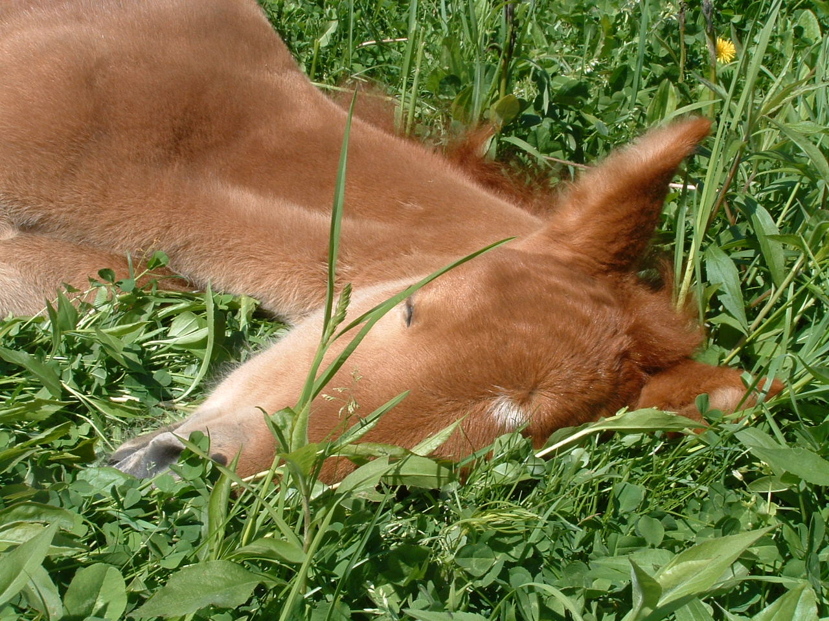
Understanding Horse Behavior

Slide 129
Equine Senses
When developing relationships and working with horses, communication is the key.
It is critical to provide a safe environment in a TR setting.
Beginning a process of understanding the horse senses, instincts and implications is a step in predicting behaviors, managing risks and increasing positive relationships between equines and humans.

Slide 130
Smell
The horse’s sense of smell is thought to be very acute and it allows him to recognize other horses and people.
Smell also allows horses to evaluate situations.
This means one should always allow horses the opportunity to become familiar with new objects and new environments by smelling.
It is recommended that you not carry treats on your person as horses may try to go after them.
Volunteers should be discouraged from eating and having food in the presence of the horses.

Slide 131
Hearing
A horse’s sense of hearing is also thought to be very acute. The horse may also combine their senses of hearing and sight to become familiar with new or alerting sounds.
Hearing and not seeing is often the cause of the freeze, flight, or fight response.

Slide 132
Sight
Since the horse is a prey animal, his eyes are set on either side of the head, so there is good peripheral (lateral) vision, but poorer frontal vision.
A horse focuses on objects by raising or lowering his head.
The horse’s visual memory is very accurate but very specific.
Horses see quite well in the dark, due to the large size of their eyes.
It is believed that horses do see in color but rather like a human with red/green color blindness.

Slide 133
Taste
Taste is closely linked to the sense of smell and helps the horse to distinguish palatable foods and other objects.

Slide 134
Touch
A Horse can feel a mosquito landing on his body.
Stroking a horse to show appreciation is much more appreciated than slapping or patting.
Use “light” hands whenever possible. This will be demonstrated in the second part of this orientation.

Slide 135
The Sixth Sense
Horses do have a “sixth sense” when evaluating the disposition of those around them.
Horses are masters of using and understanding body language and can be hyper-sensitive in detecting the moods of their handlers and riders.
A good therapy horse is often chosen for his sensitive response to the rider.
It is important to let the instructor/therapist know if you are having a difficult time relating to or getting along with a particular horse.

Slide 136
Reading the Ears
Many times you can tell what a horse is thinking by looking at his ears.
Note the position of the horses’ ears on the next few slides and see if you can guess what’s on their minds.

Slide 137
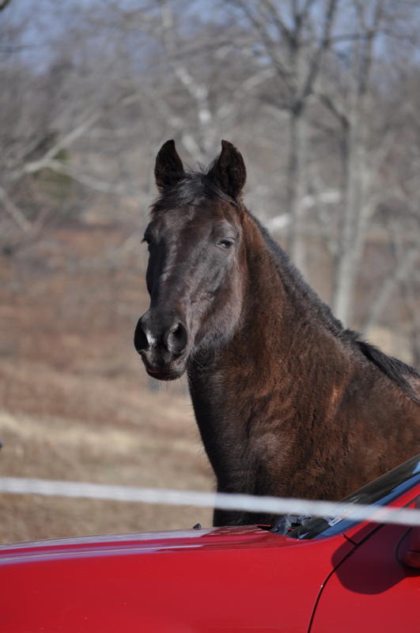

Slide 138
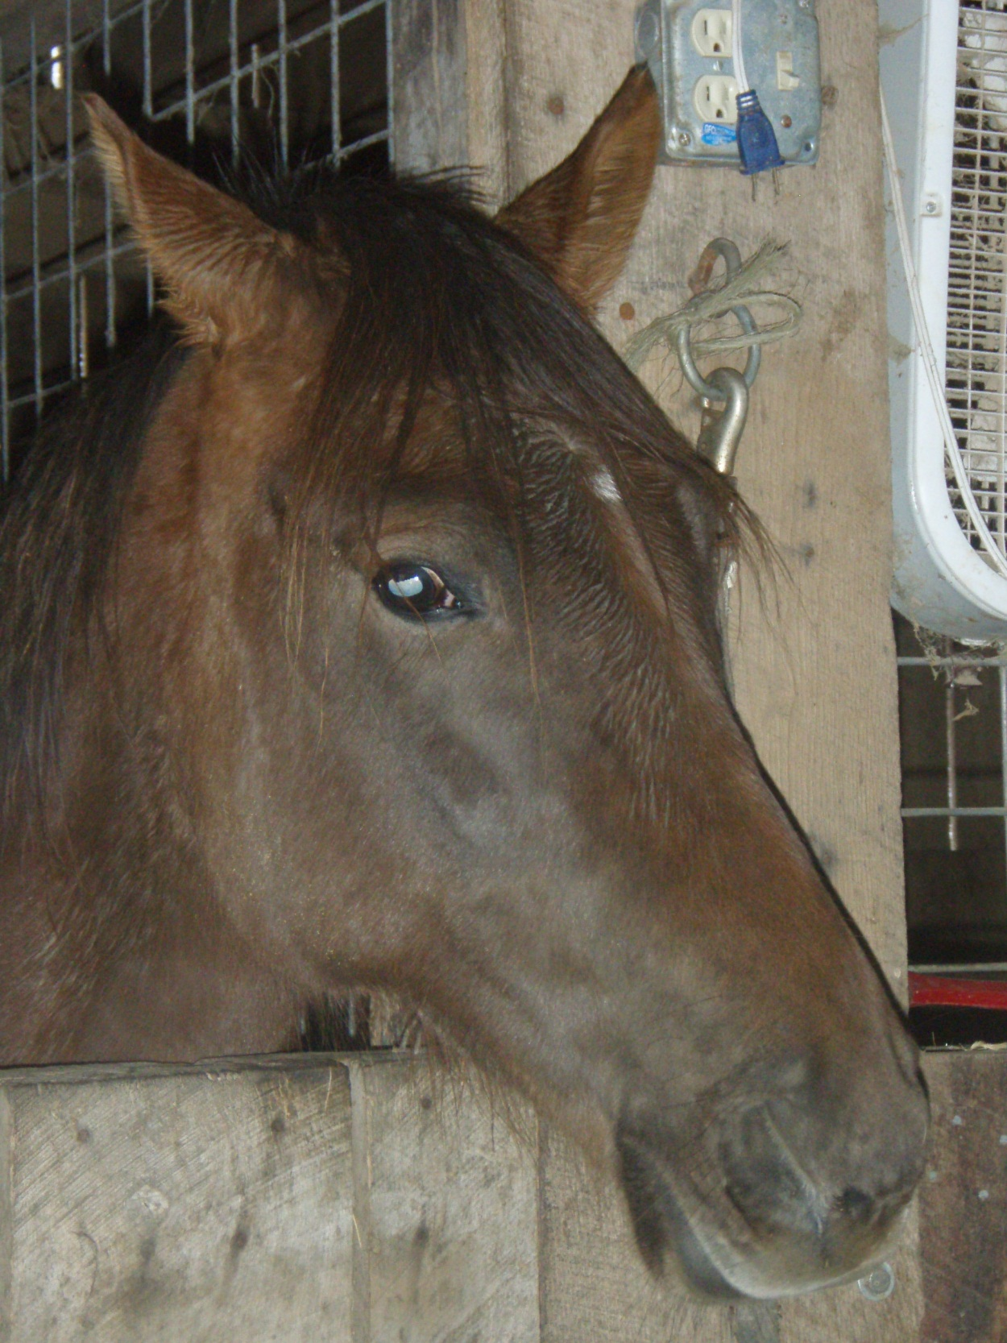

Slide 139
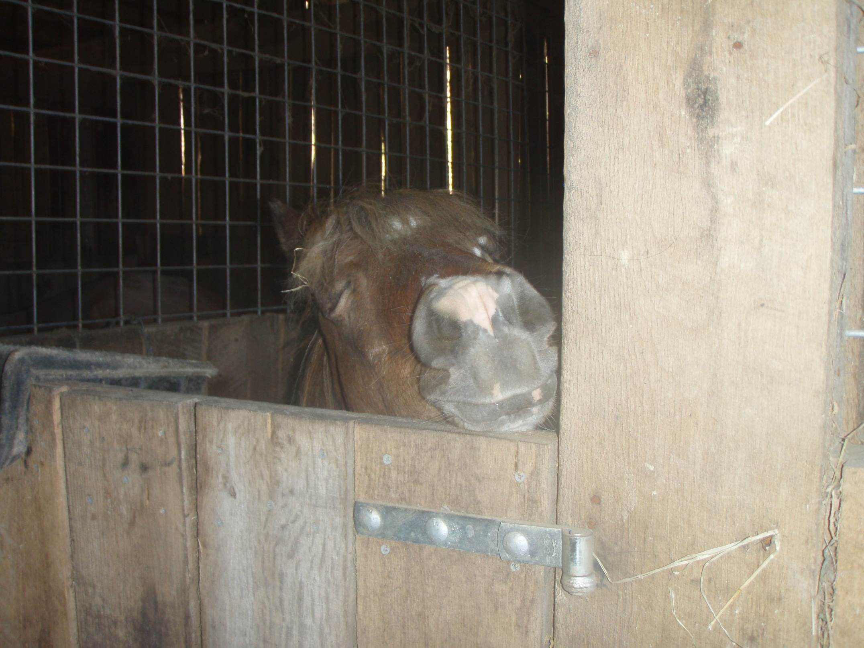

Slide 140
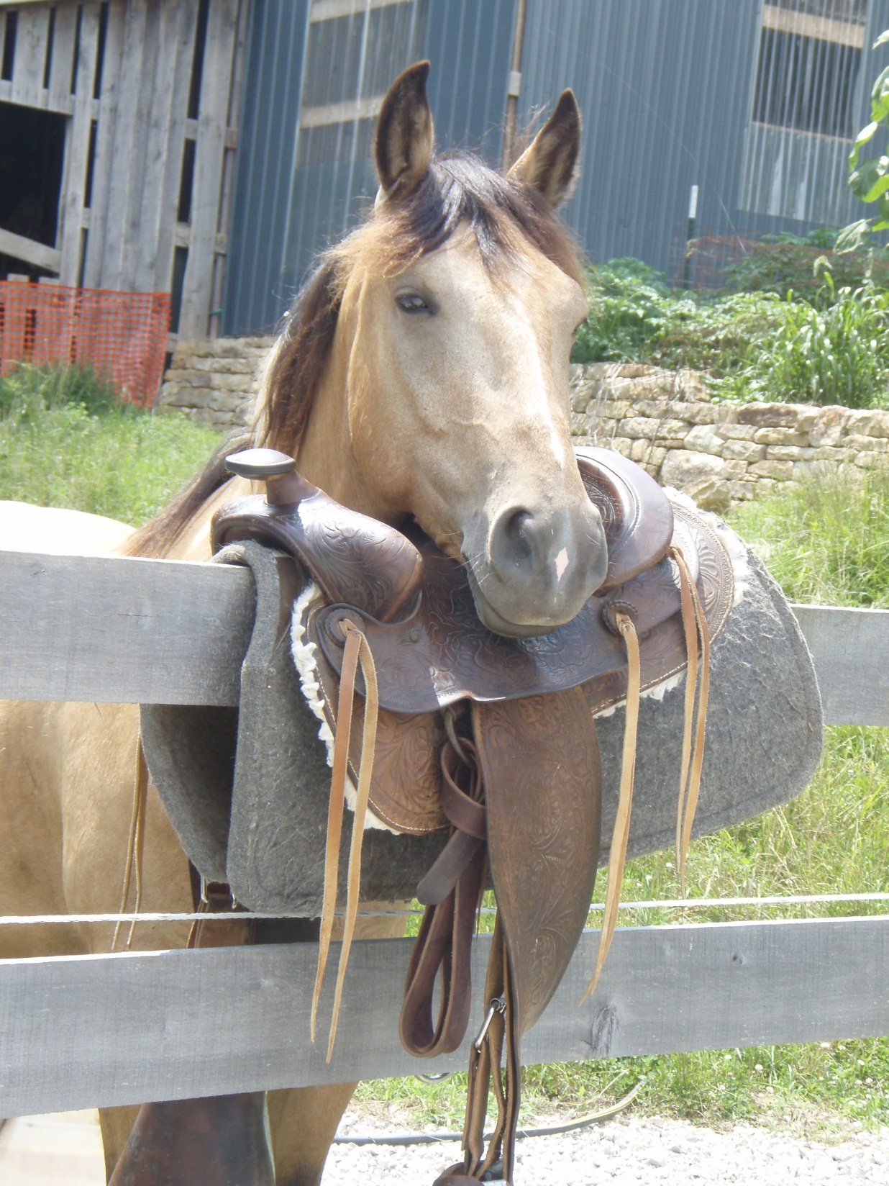

Slide 141
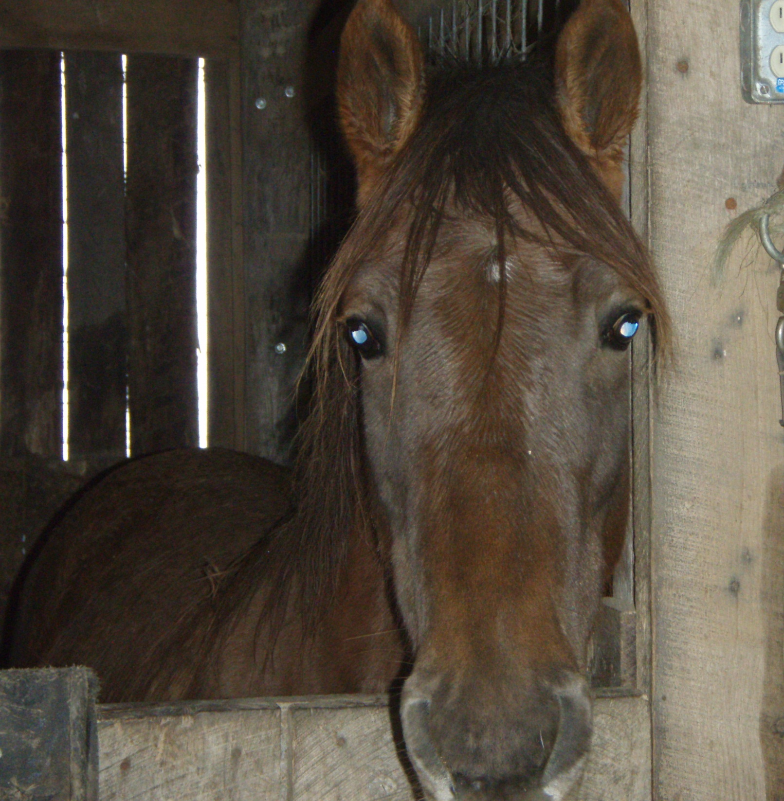

Slide 142
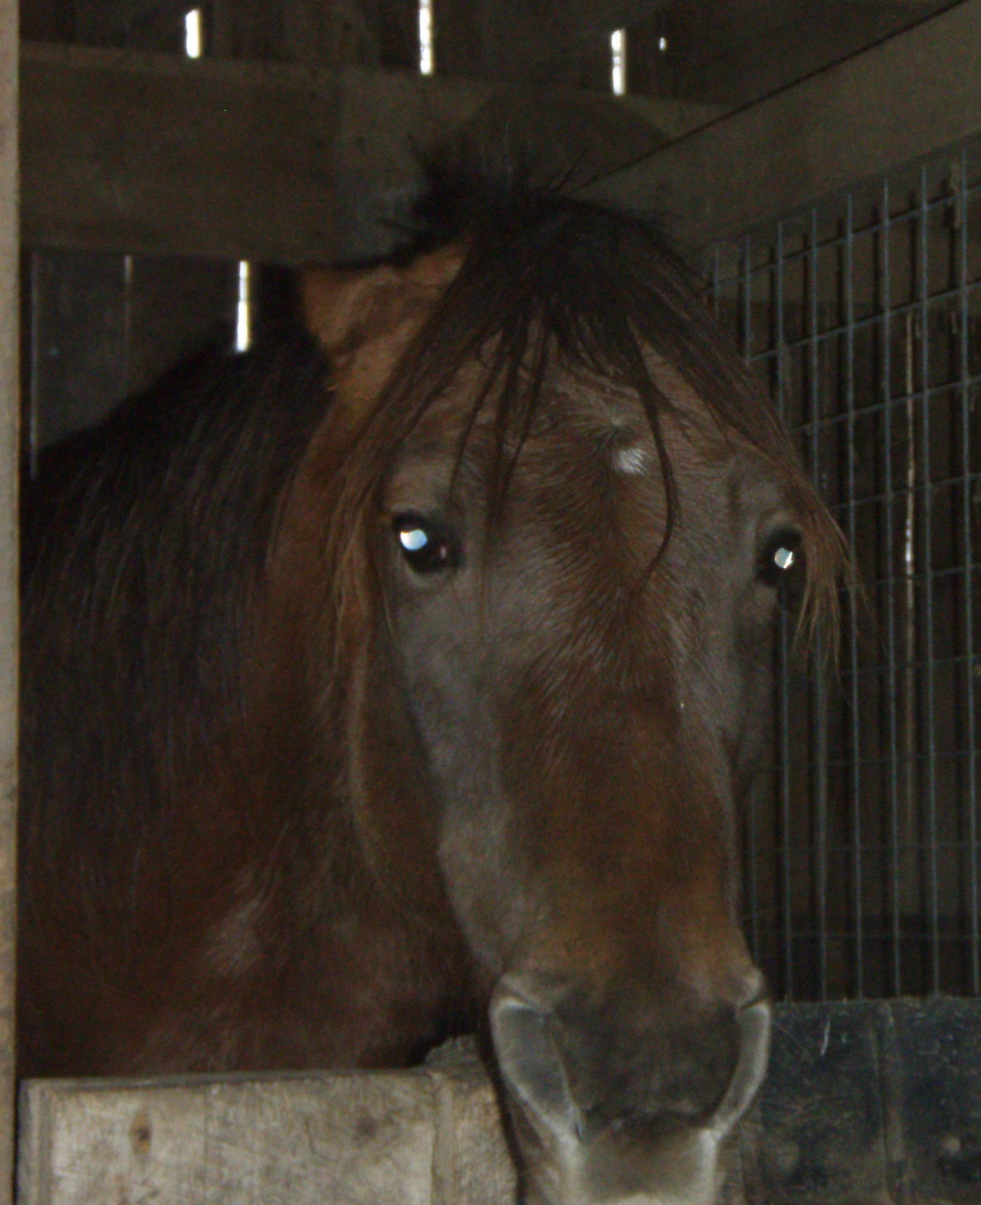

Slide 143
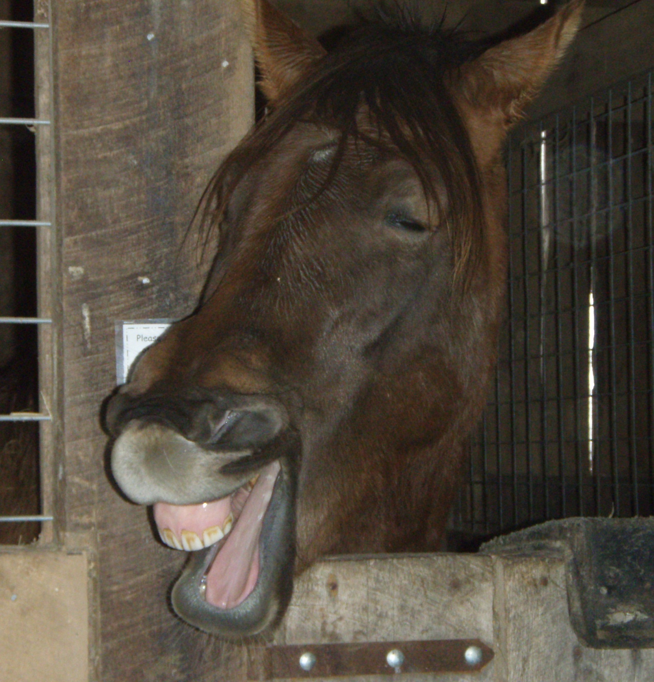

Slide 144
The Horse’s Lifestyle
In addition to understanding the horse’s senses, we need to increase our awareness of the horse’s lifestyle so that we can respond appropriately to his needs, reactions and situations.

Slide 145
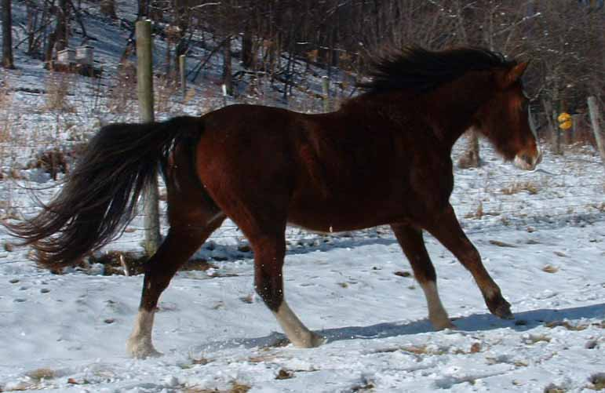
Flight is a Natural Instinct
A horse would rather turn and run away from danger than stay and fight it.

Slide 146
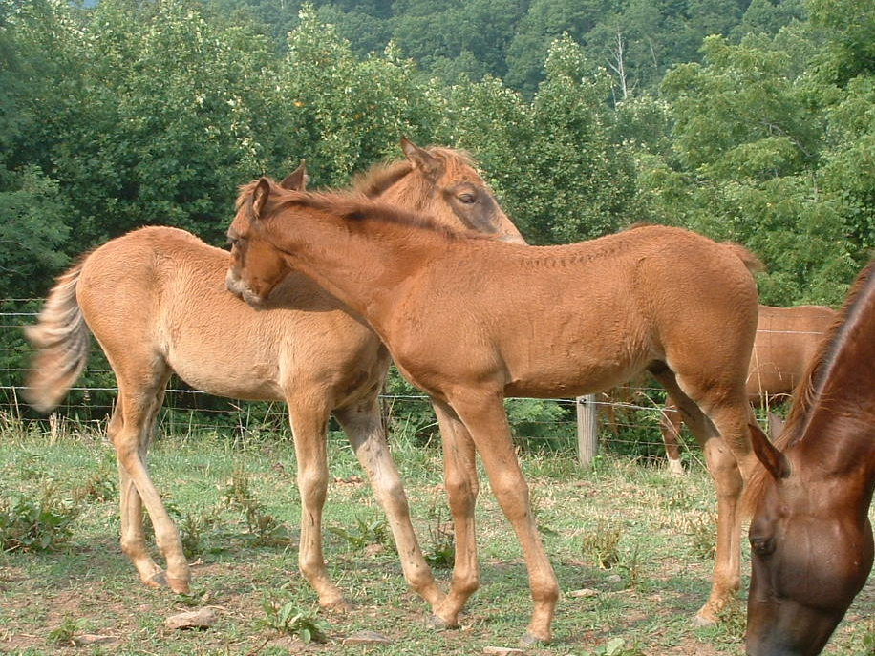
Herd Behavior
Horses like to stay together in a herd or group with one or two horses dominant and a pecking order among the rest.

Slide 147
Natural Horsemanship Concepts
Love, Language and Leadership in equal doses.
Use “phases” of pressure. Ask, Tell, Demand
Communication, Understanding and Psychology VS Mechanics, Fear and Intimidation.
Mutual Respect.

Slide 148
Happy Trails!
The Kentucky Foothills
Therapeutic Horsemanship Center
7822 HWY 2004
MC Kee, KY 40447
606-965-2158
KFTHC@prtcnet.org
www.KFTHC.us
Please continue to view the following slides to check your comprehension of the information presented.

Slide 149
What are three responsibilities of a Sidewalker?
What is the MAIN responsibility of the Horse Leader?
What are three other responsibilities of a Horse Leader?
What are three positions a sidewalker might be asked to assume to support a rider?
If you are riding outside, what should you do if you hear thunder?

Slide 150
What is the safest way to approach an equine?
What are five KFTHC Safety Guidelines for working around horses?
What should you wear when working at KFTHC?
What does “Person-First Language” mean
What is Sensory Integration?

Slide 151
What cues might you receive by looking at a horse’s ears?
What are three important concepts of Natural Horsemanship practice?
What does the practice of “Universal Precautions” involve?
What should be done during a lesson if you are a member of a support team and a horse emergency occurs?
For safety involving a possible fire, of what should you be aware beforehand?
Thank you for taking the time to view this slide show and answering these questions. Now you need to schedule some time to get to know KFTHC’s horses and participants first-hand! Call Louise, Mark or Cheryl

Slide 159
Contact Information:
Executive Director: Mark A. Martin office~ 606-965-2158 KFTHC@prtcnet.org cell~ 606-975-0757 frinc@prtcnet.org
Lead Instructor/ Program Director: Cheryl Martin office~ 606-965-2158
cell~ 606-521-0710 cheryl.martin360@yhoo.com
Volunteer Coordinator: office~ 859-623-4513 emily_wells14@mymail.eku.edu
sign_man79@live.net
Lesson Coordinator: Kerry Taulbee 859-303-3412
  kerrytaulbee@hotmail.com
Web Master: Sue Wells office~859-623-4513 wellsfamily55@yahoo.com

